Slide 1
Fitting the Valsalva Maneuver model to data

Slide 2
sincope

Slide 3
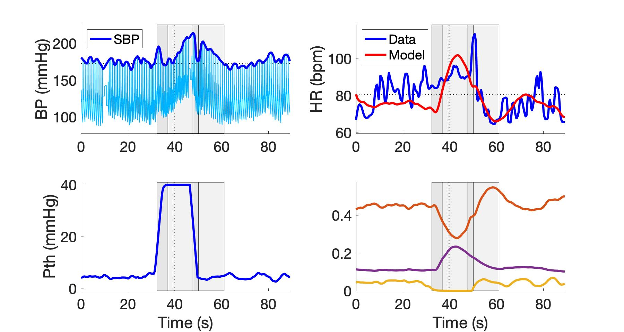
subject_W8VM2.jpeg
Parasympathetic
Sympathetic
Respiratory

Slide 4
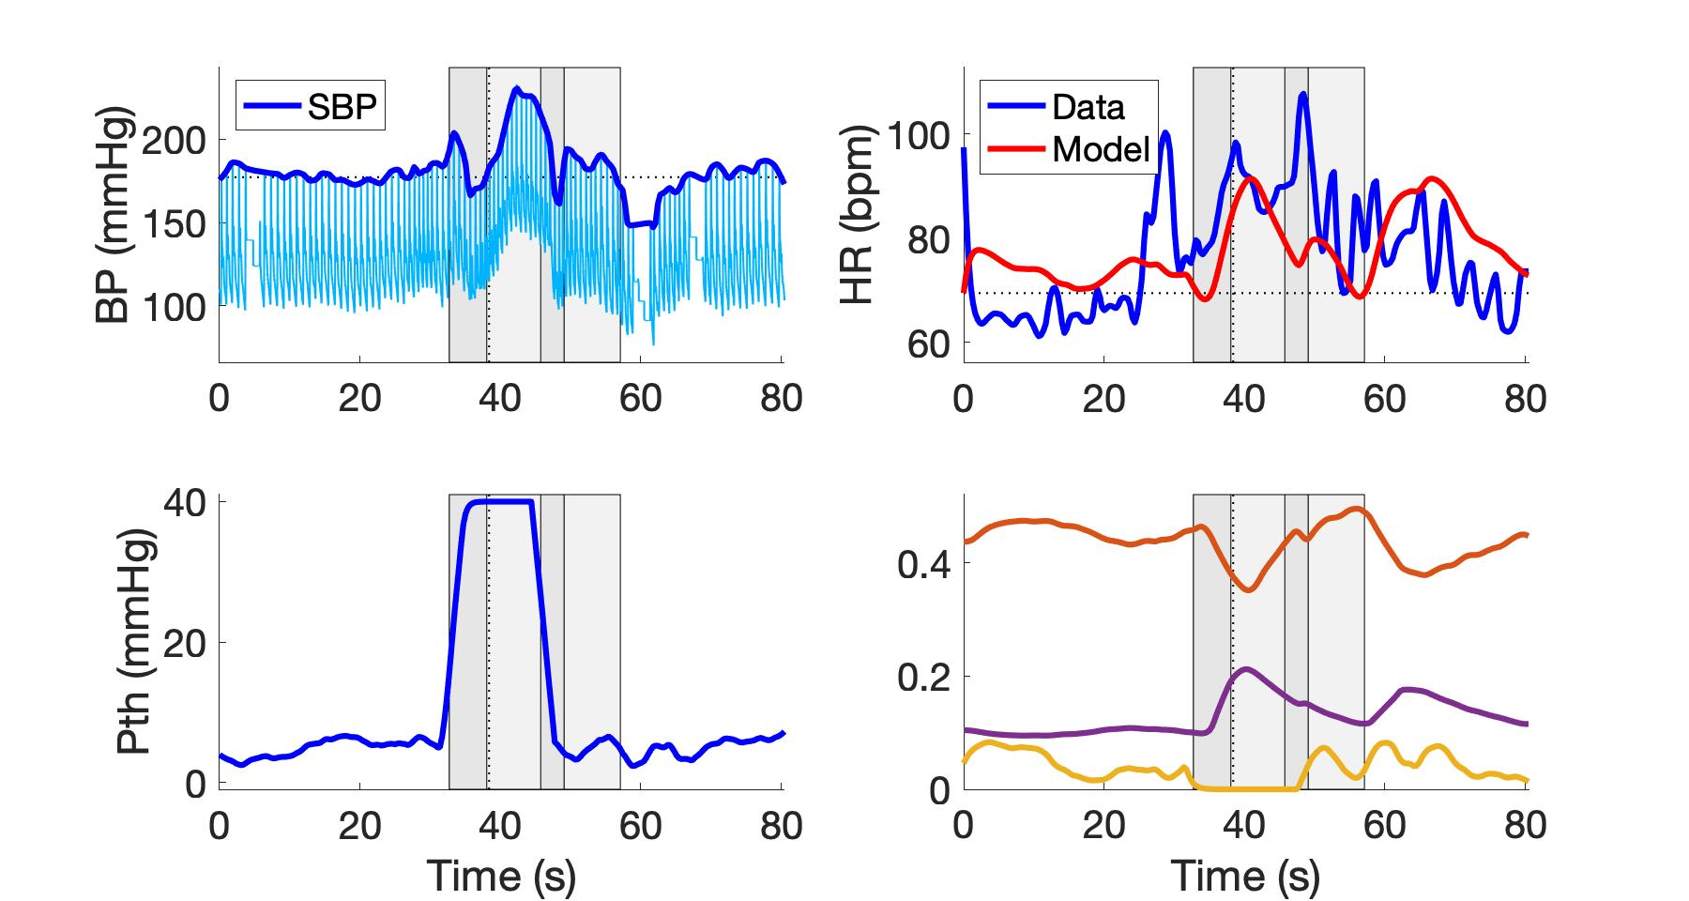
subject_W8VM3.jpeg
Parasympathetic
Sympathetic
Respiratory

Slide 5
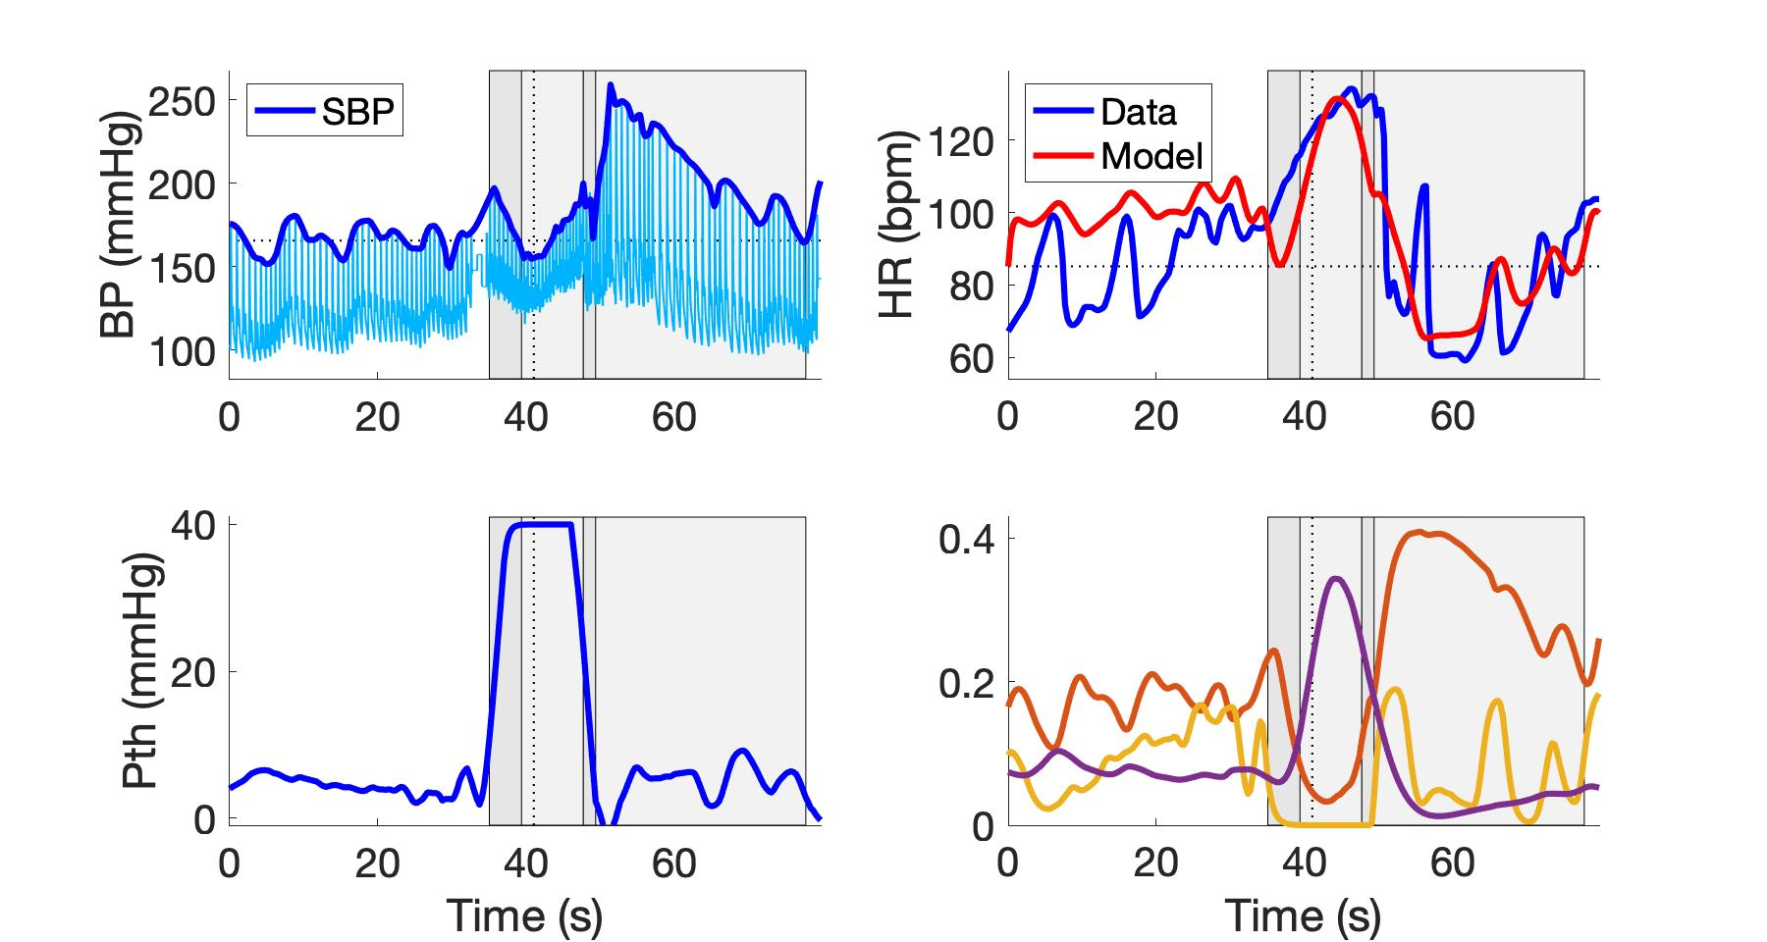
subject_W9VM2.jpeg

Slide 6
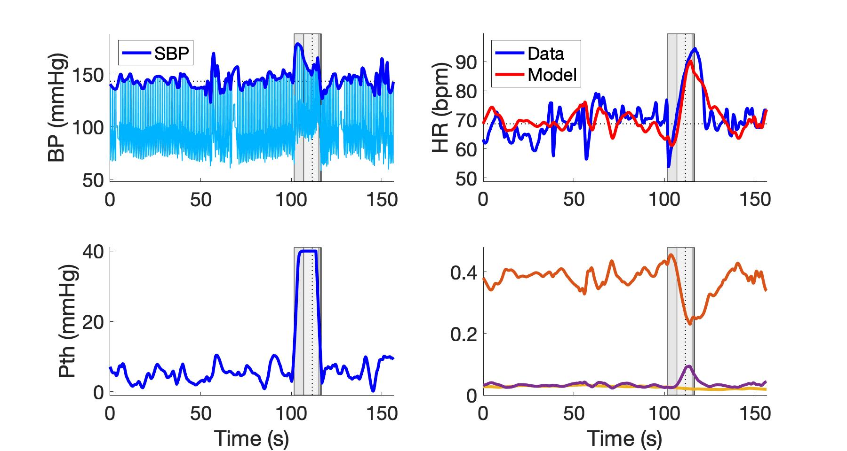
subject_W12VM1.jpeg
Parasympathetic
Sympathetic
Respiratory

Slide 7
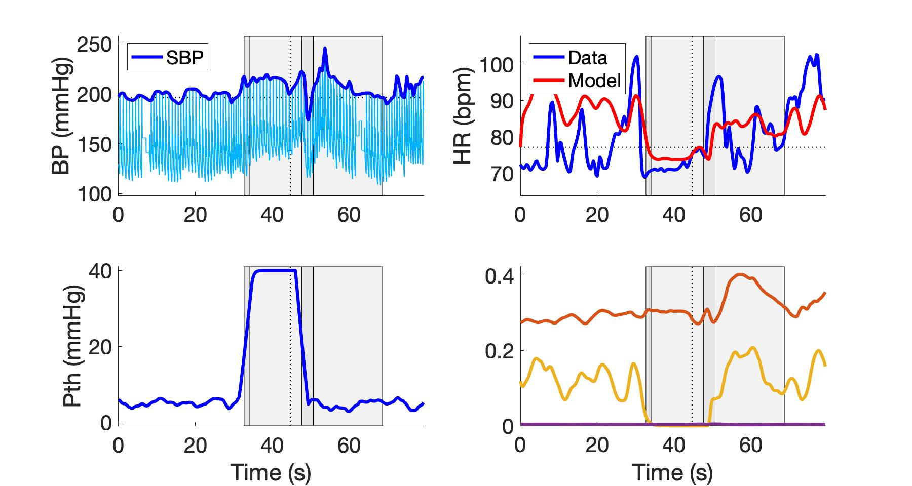
subject_W16VM1.jpeg
Parasympathetic
Sympathetic
Respiratory

Slide 8
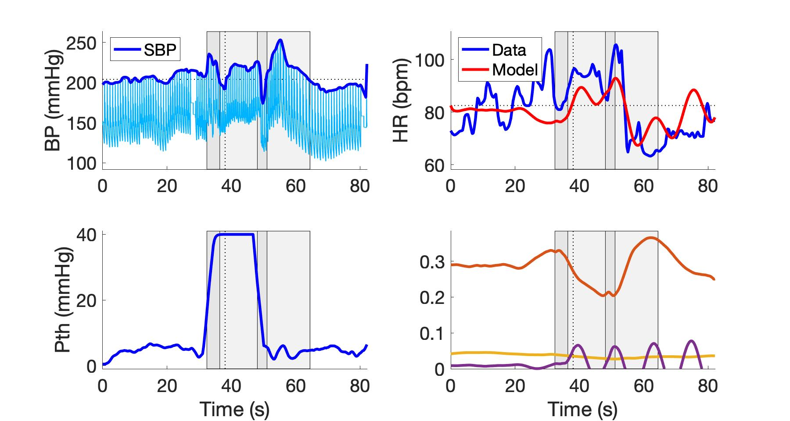
subject_W16VM2.jpeg
Parasympathetic
Sympathetic
Respiratory

Slide 9
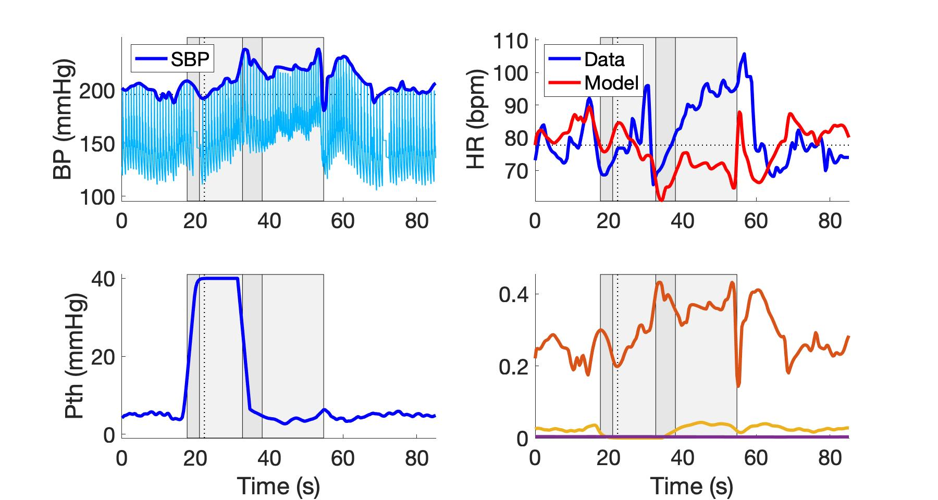
subject_W16VM3.jpeg
Parasympathetic
Sympathetic
Respiratory

Slide 10
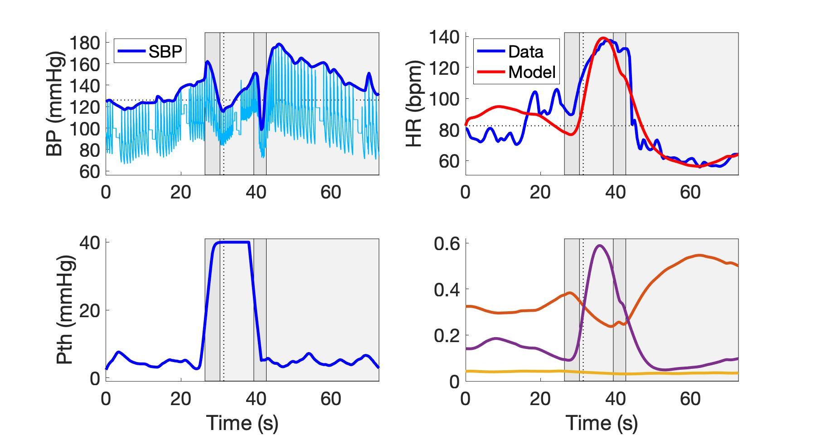
subject_W19VM1.jpeg
Parasympathetic
Sympathetic
Respiratory

Slide 11
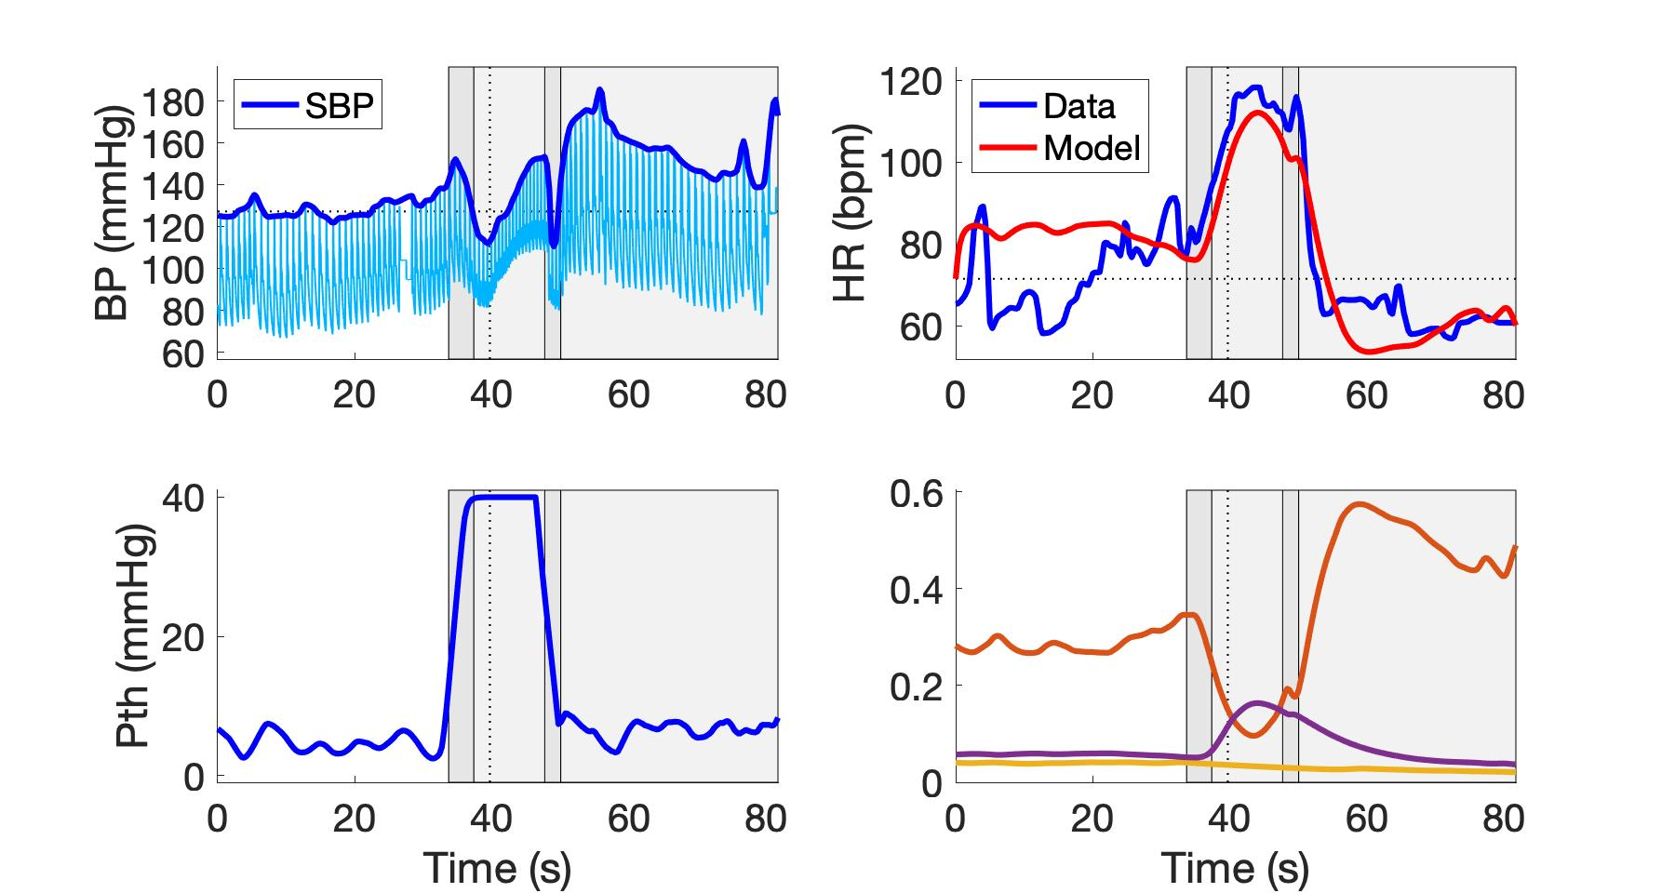
subject_W19VM2.jpeg
Parasympathetic
Sympathetic
Respiratory

Slide 12
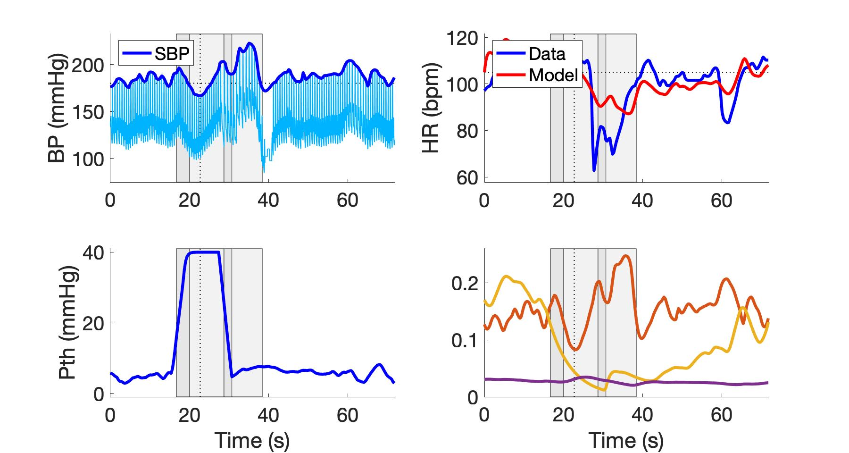
subject_W21VM1.jpeg
Parasympathetic
Sympathetic
Respiratory

Slide 13
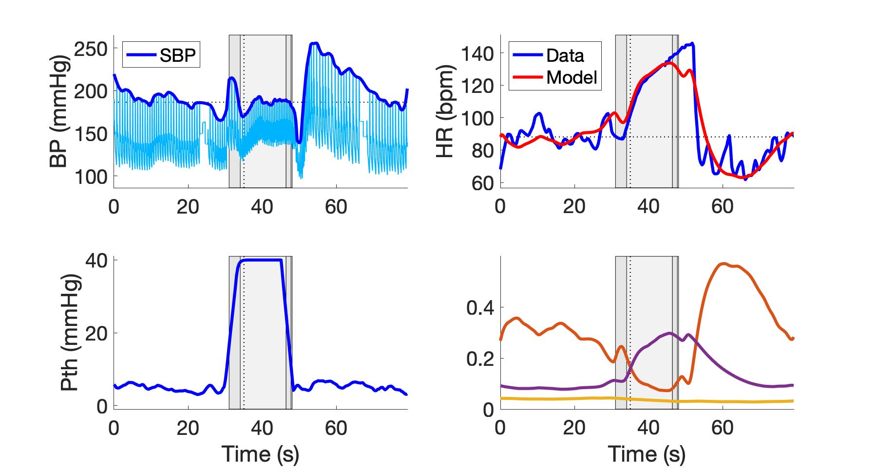
subject_W21VM2.jpeg
Parasympathetic
Sympathetic
Respiratory

Slide 14
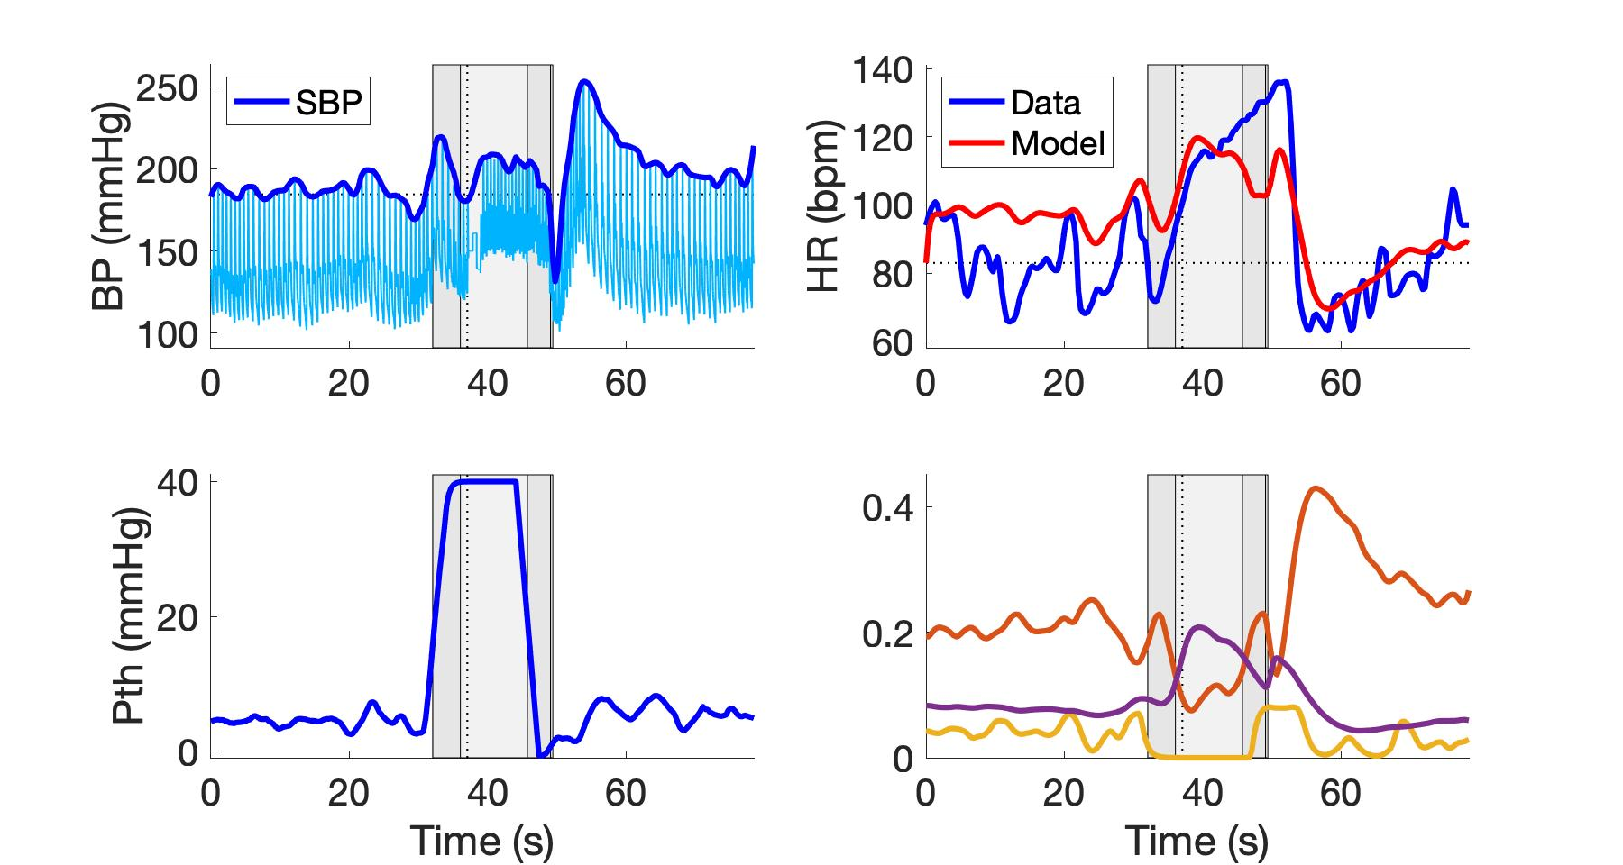
subject_W21VM3.jpeg
Parasympathetic
Sympathetic
Respiratory

Slide 15
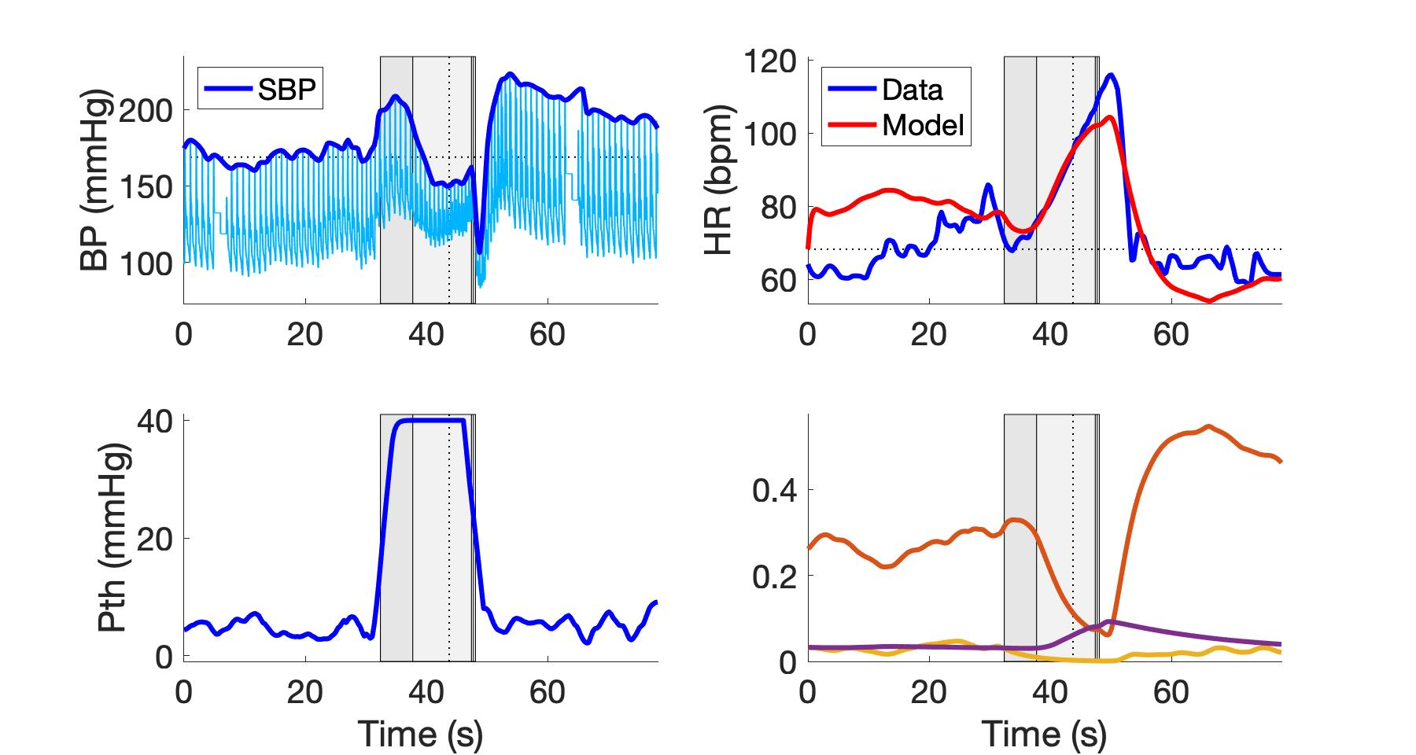
subject_W23VM1.jpeg
Parasympathetic
Sympathetic
Respiratory

Slide 16
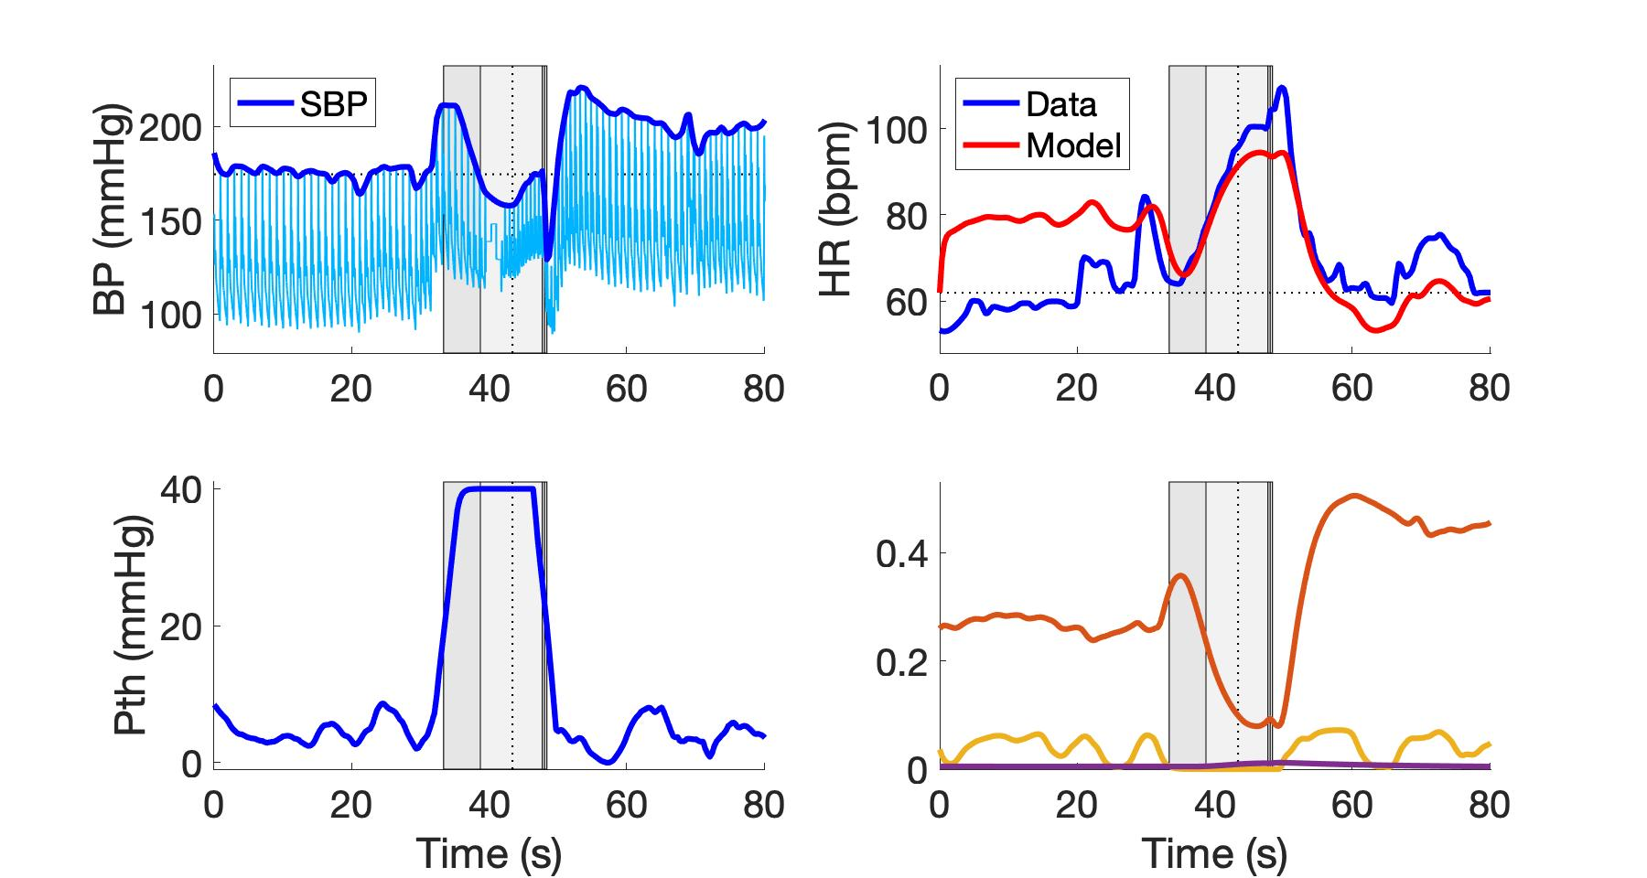
subject_W23VM2.jpeg
Parasympathetic
Sympathetic
Respiratory

Slide 17
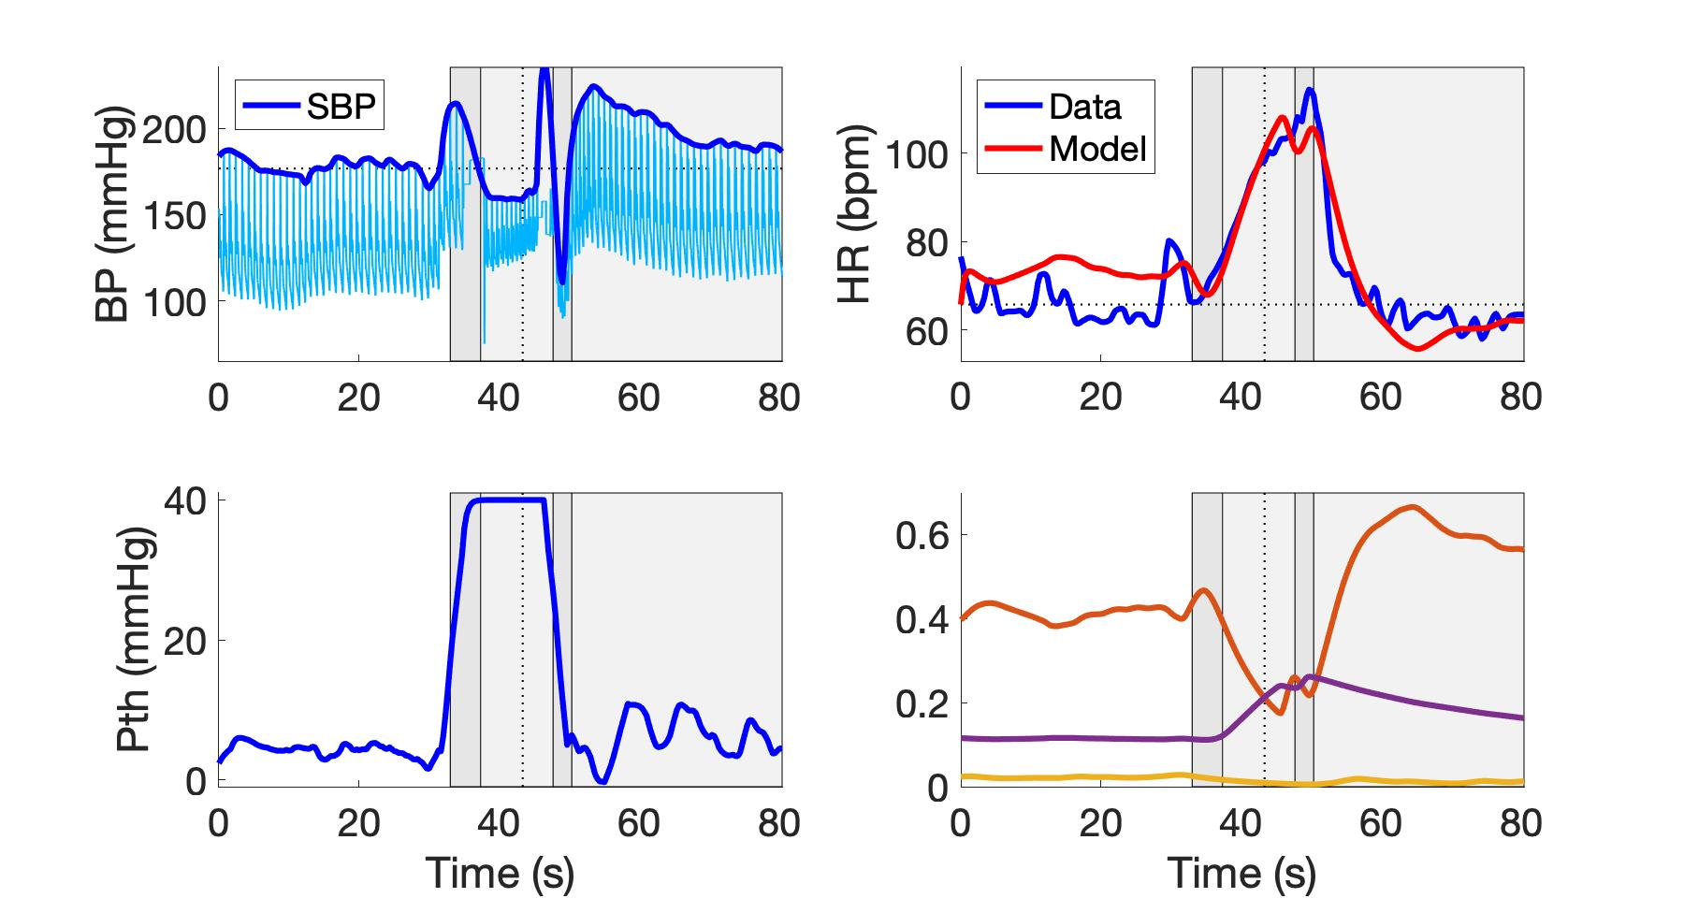
subject_W23VM3.jpeg
Parasympathetic
Sympathetic
Respiratory

Slide 18
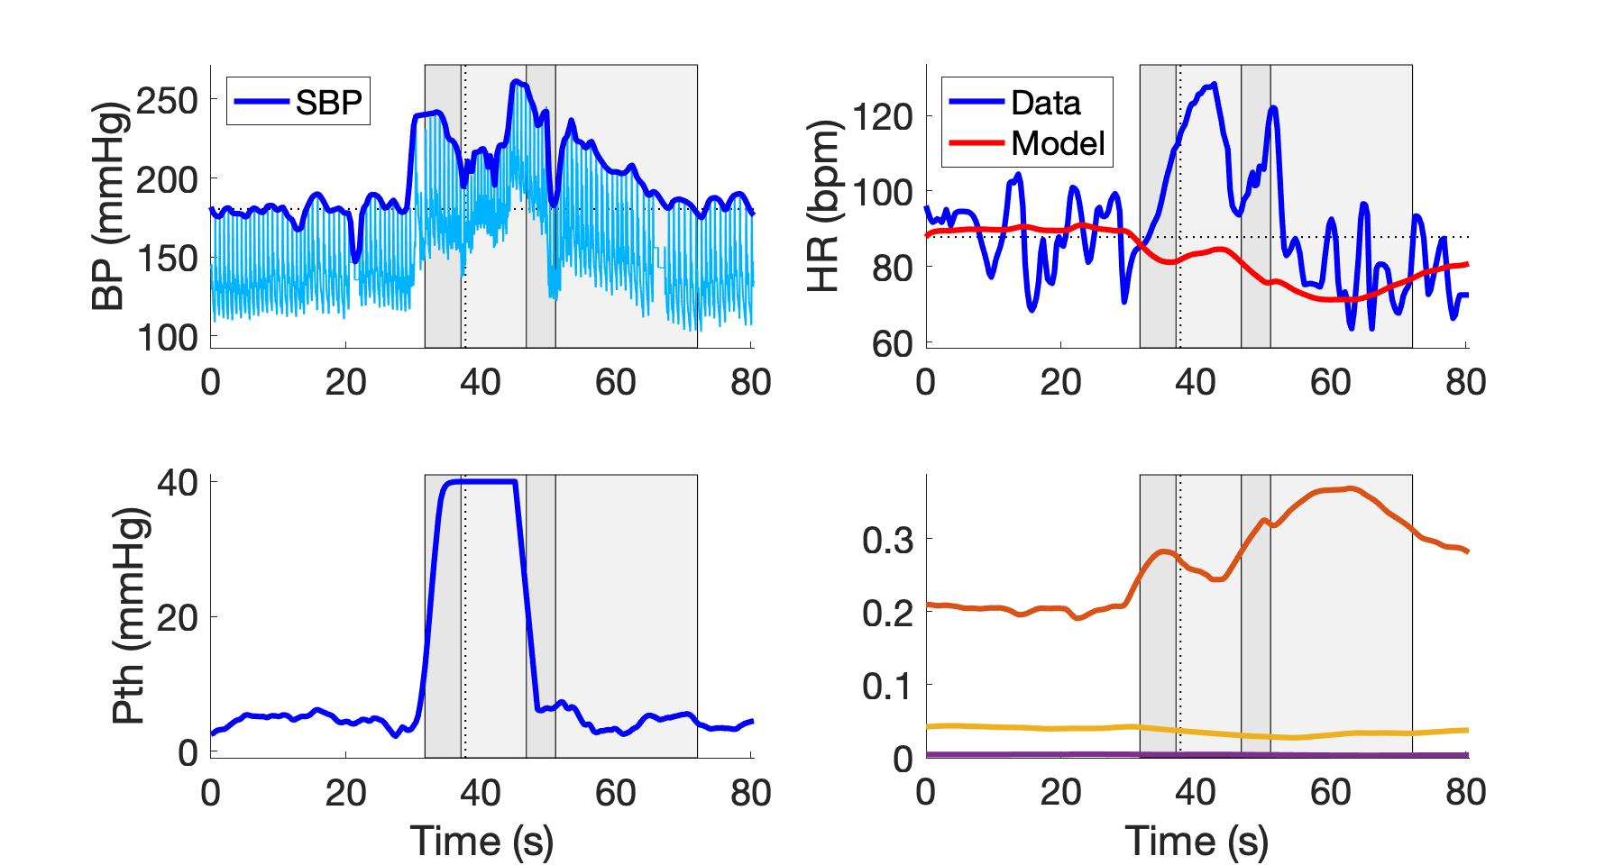
subject_W24VM2.jpeg
Parasympathetic
Sympathetic
Respiratory

Slide 19
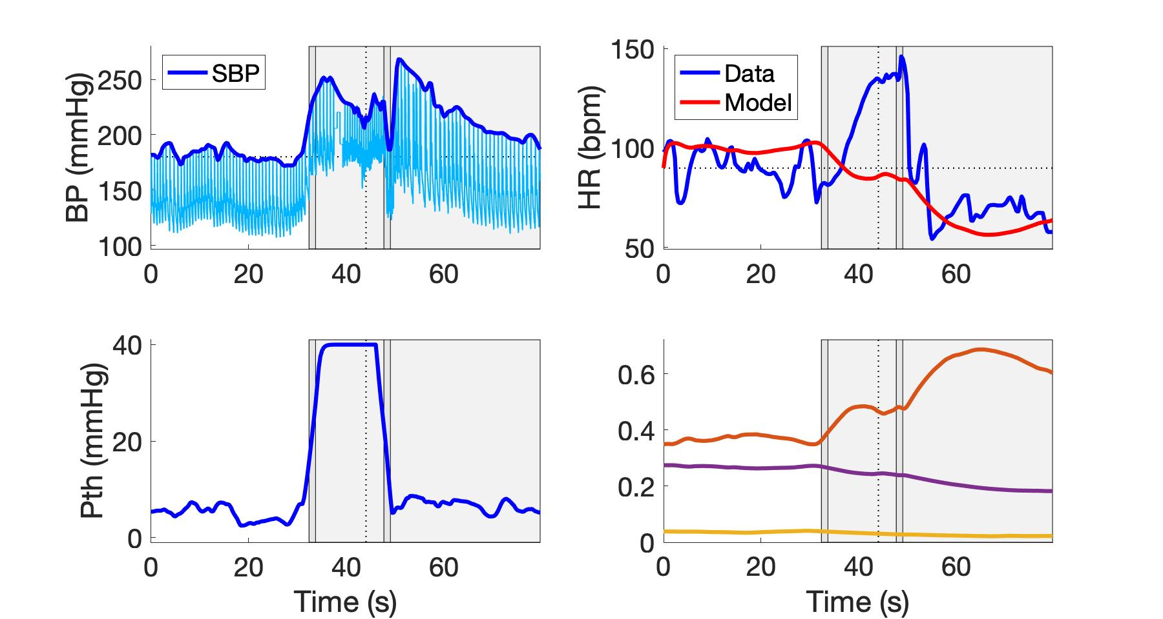
subject_W24VM3.jpeg
Parasympathetic
Sympathetic
Respiratory

Slide 20
Controles

Slide 21
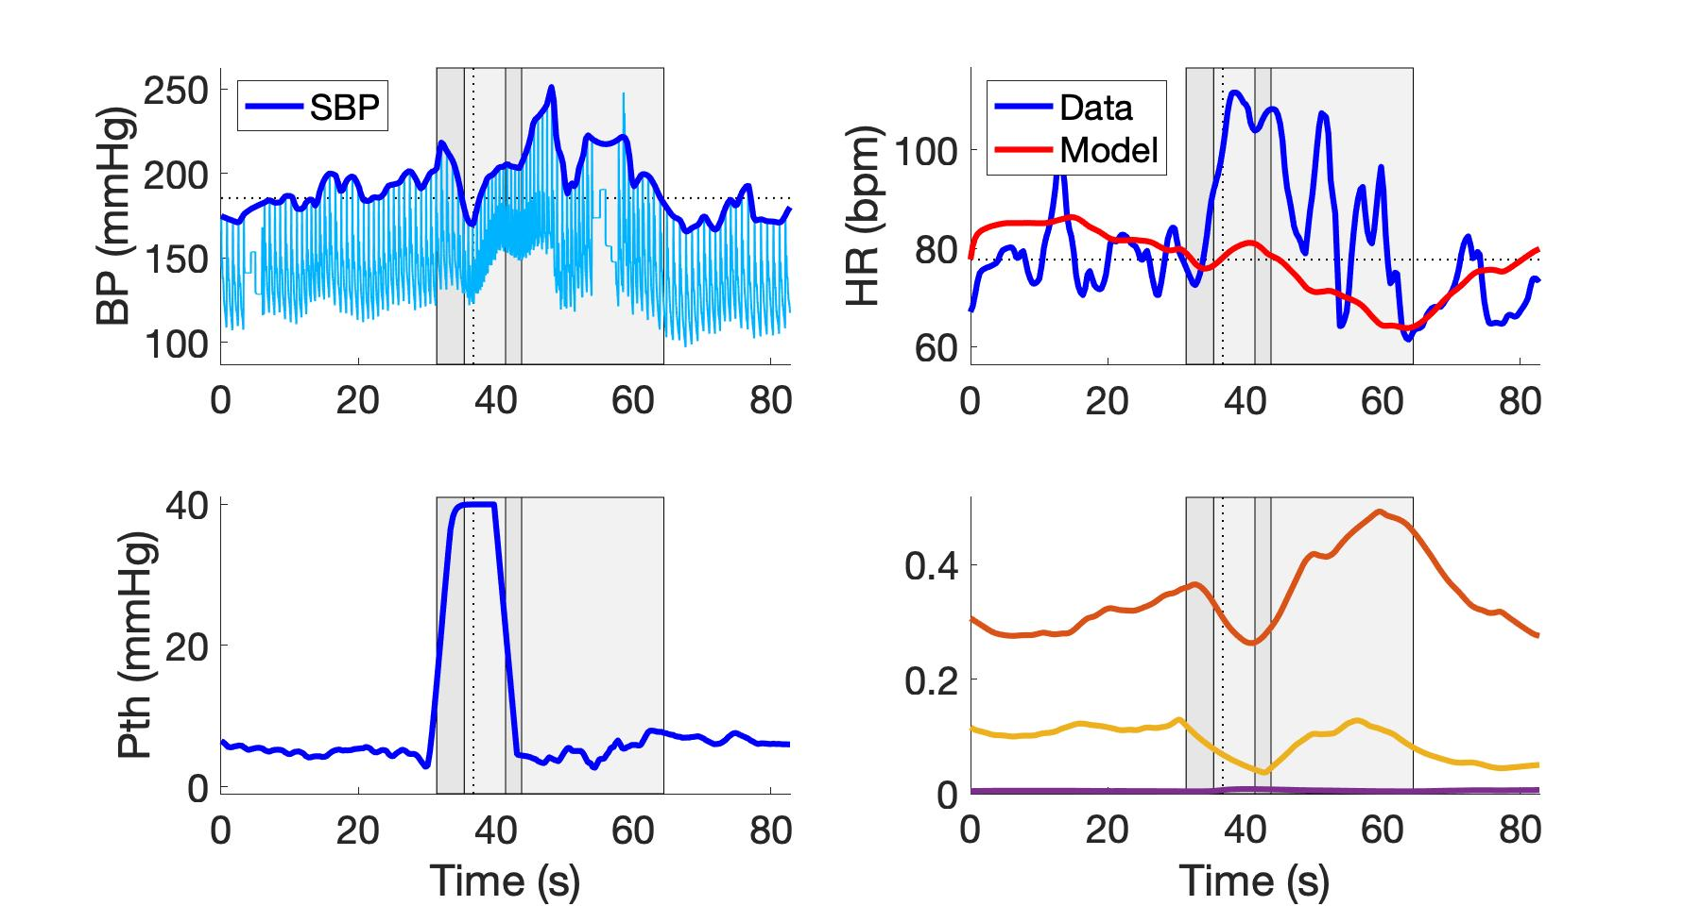
subject_W1VM1.jpeg
Parasympathetic
Sympathetic
Respiratory

Slide 22
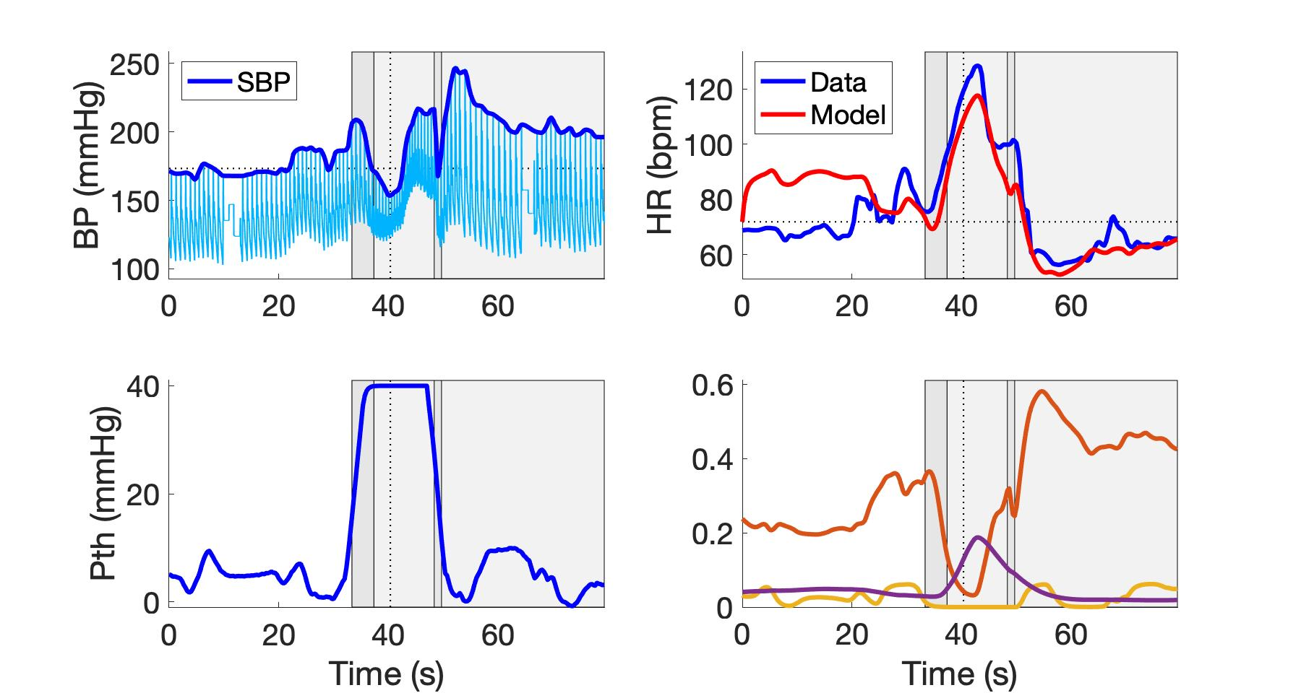
subject_W1VM2.jpeg
Parasympathetic
Sympathetic
Respiratory

Slide 23
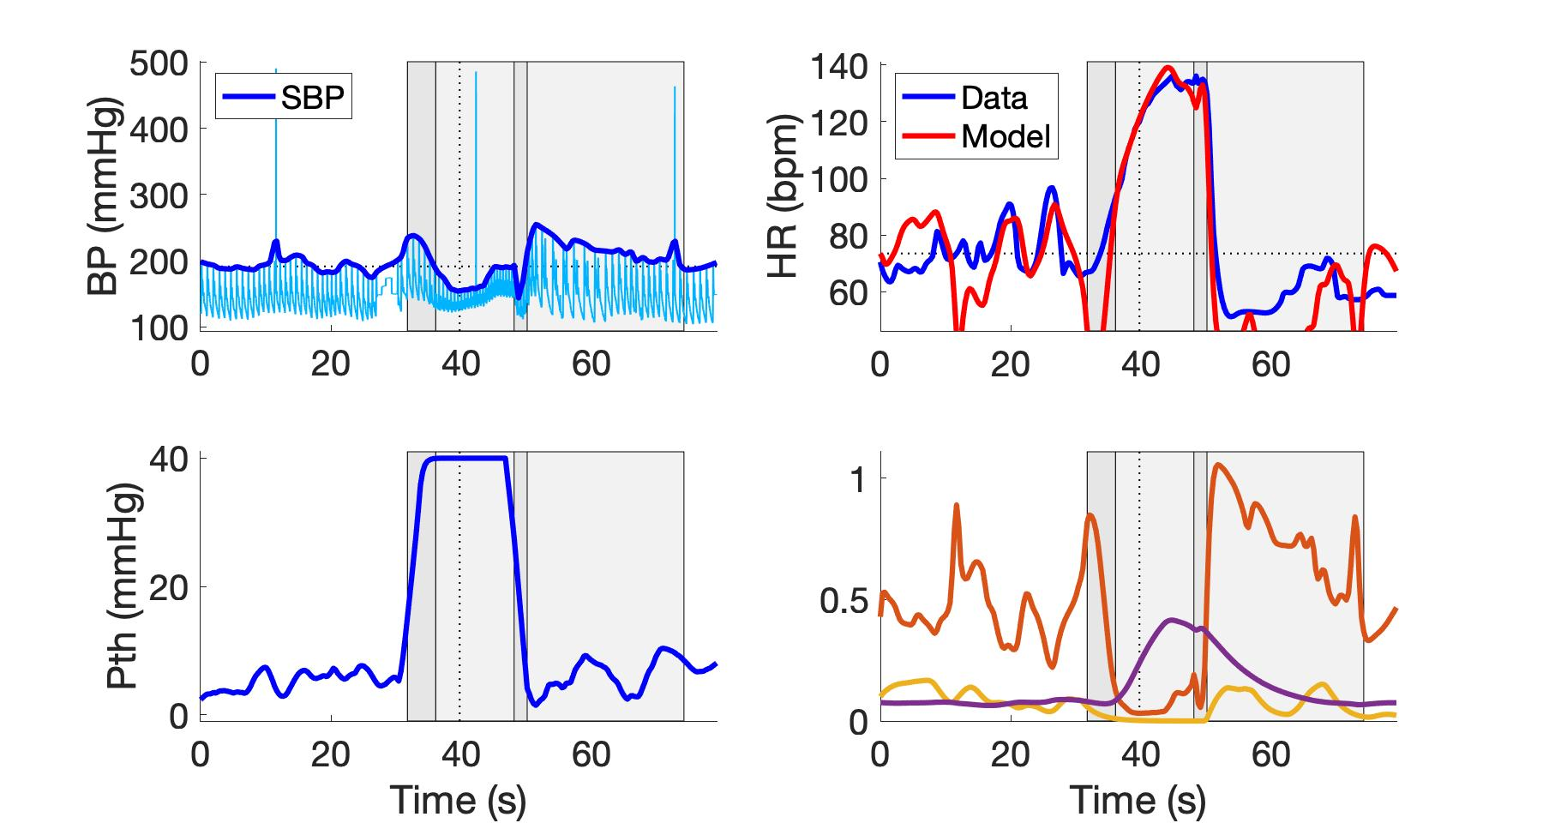
subject_W1VM3.jpeg
Parasympathetic
Sympathetic
Respiratory

Slide 24
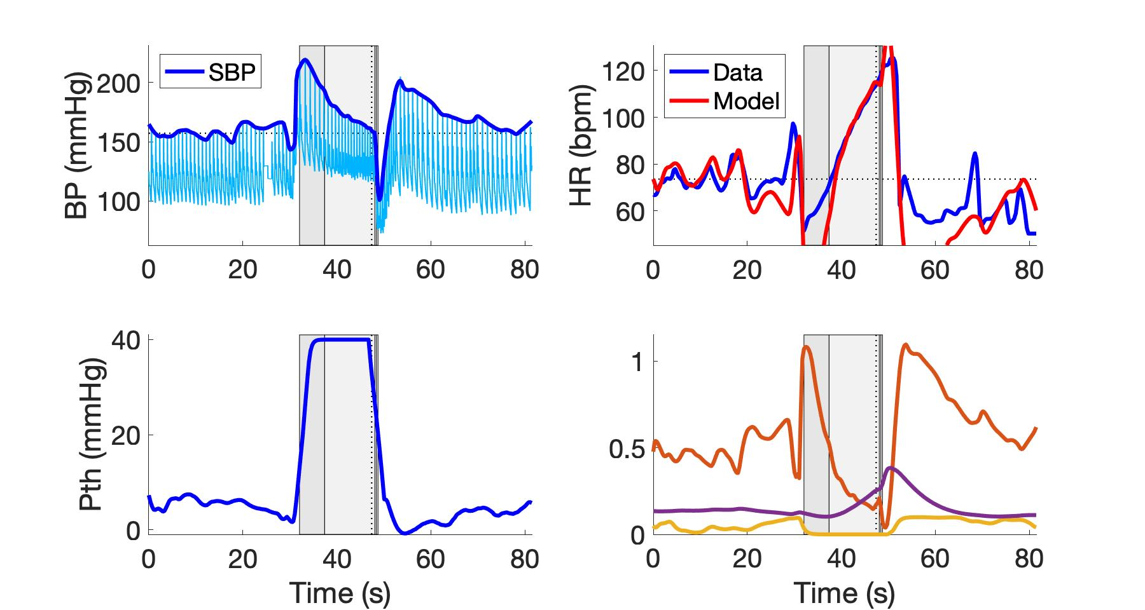
subject_W2VM2.jpeg
Parasympathetic
Sympathetic
Respiratory

Slide 25
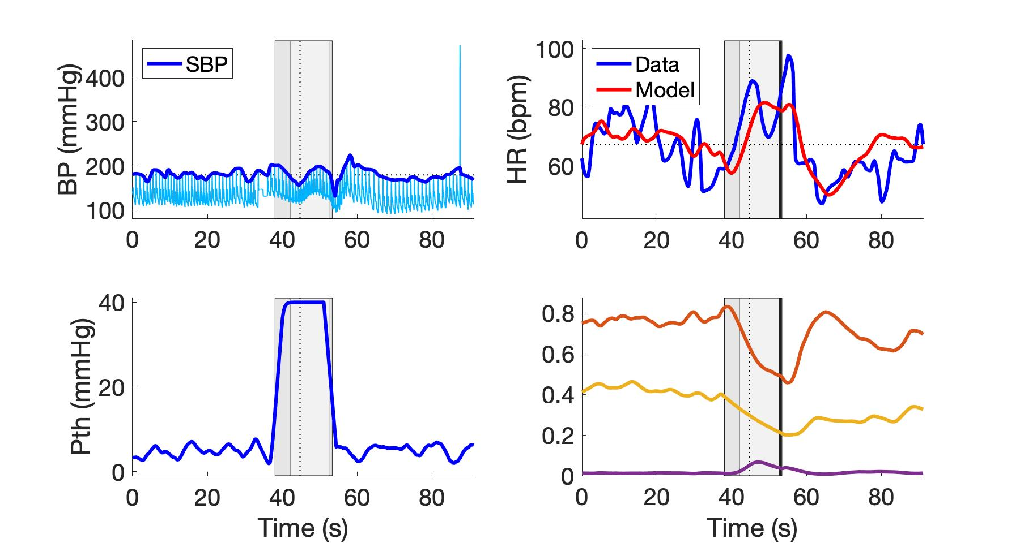
subject_W6VM1.jpeg
Parasympathetic
Sympathetic
Respiratory

Slide 26
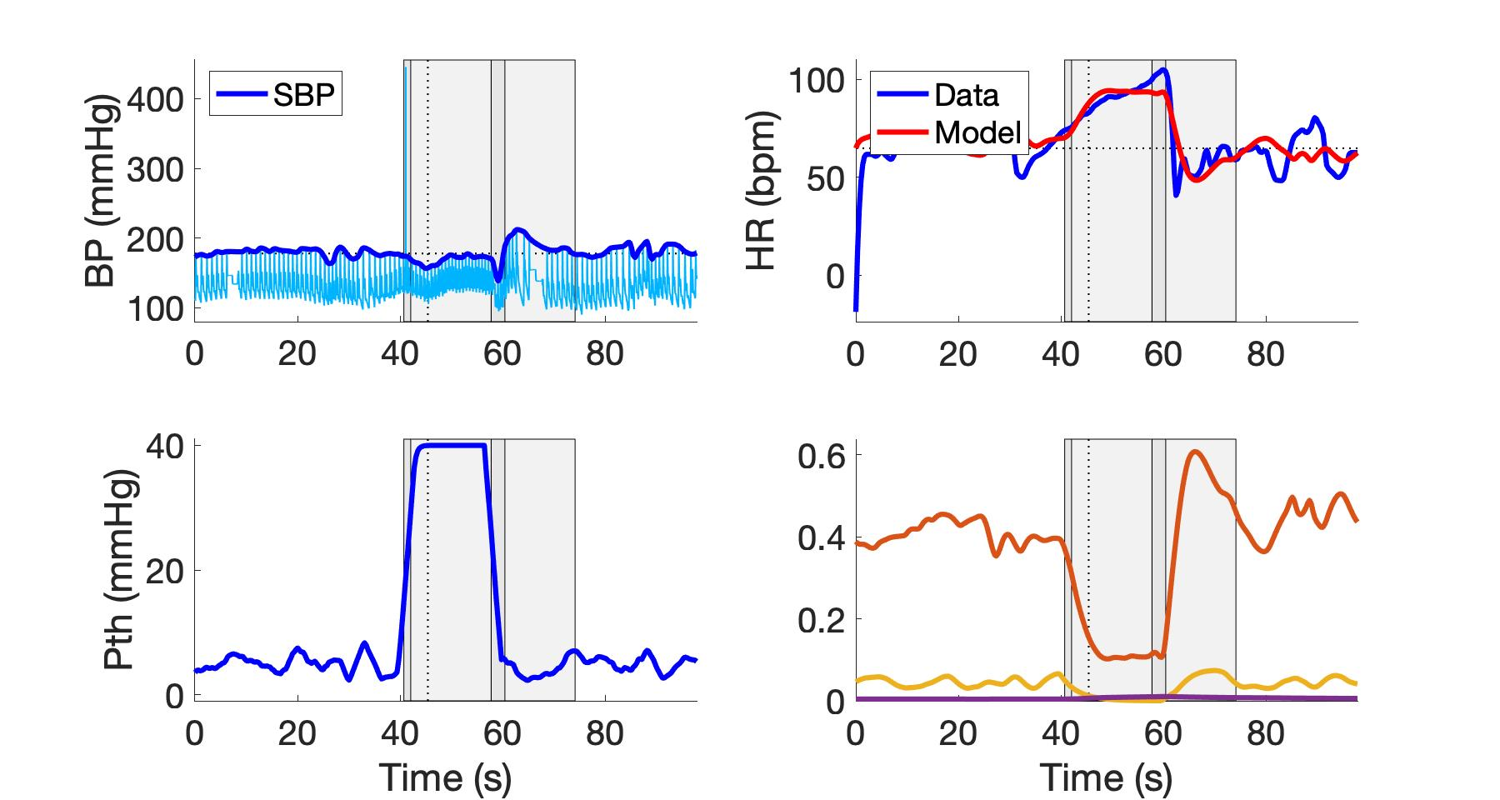
subject_W6VM2.jpeg
Parasympathetic
Sympathetic
Respiratory

Slide 27
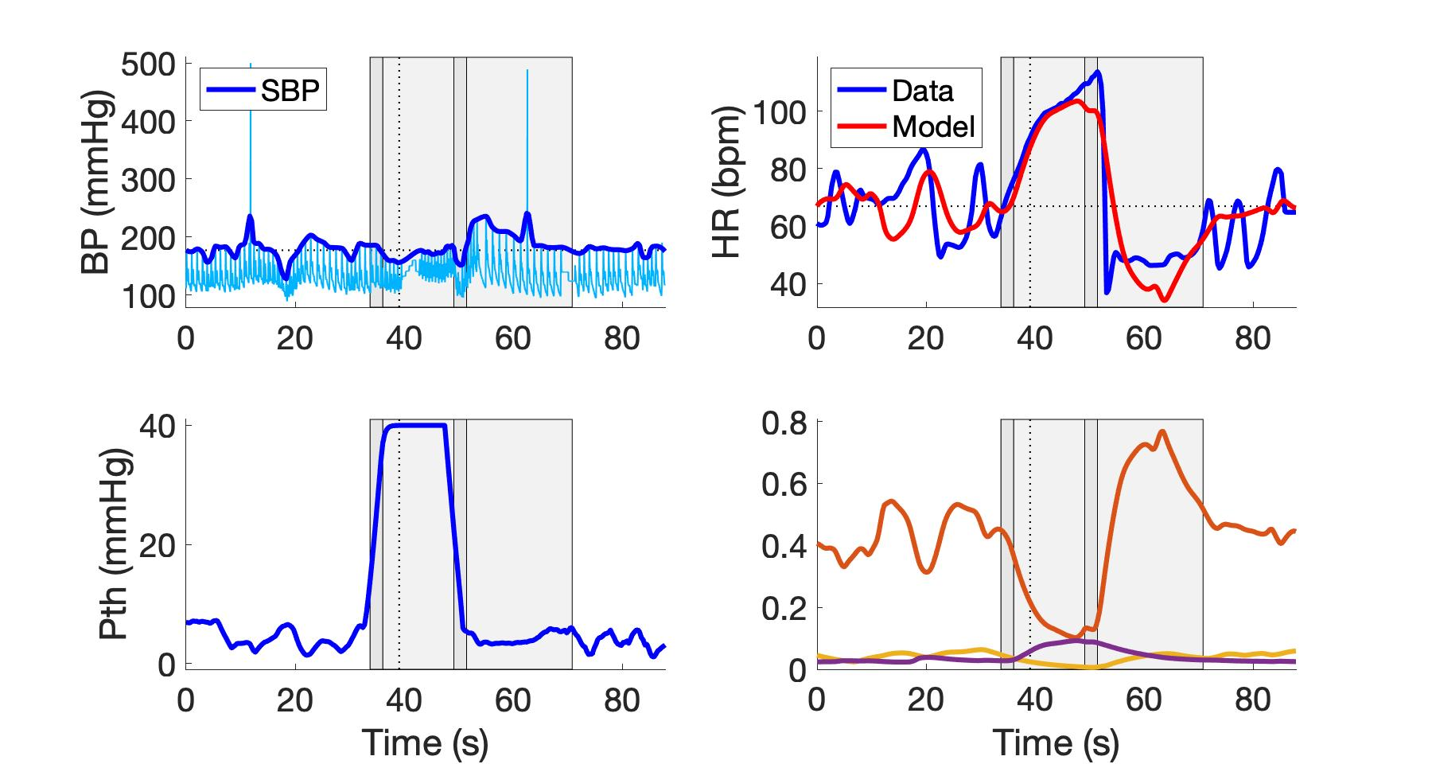
subject_W6VM3.jpeg
Parasympathetic
Sympathetic
Respiratory

Slide 28
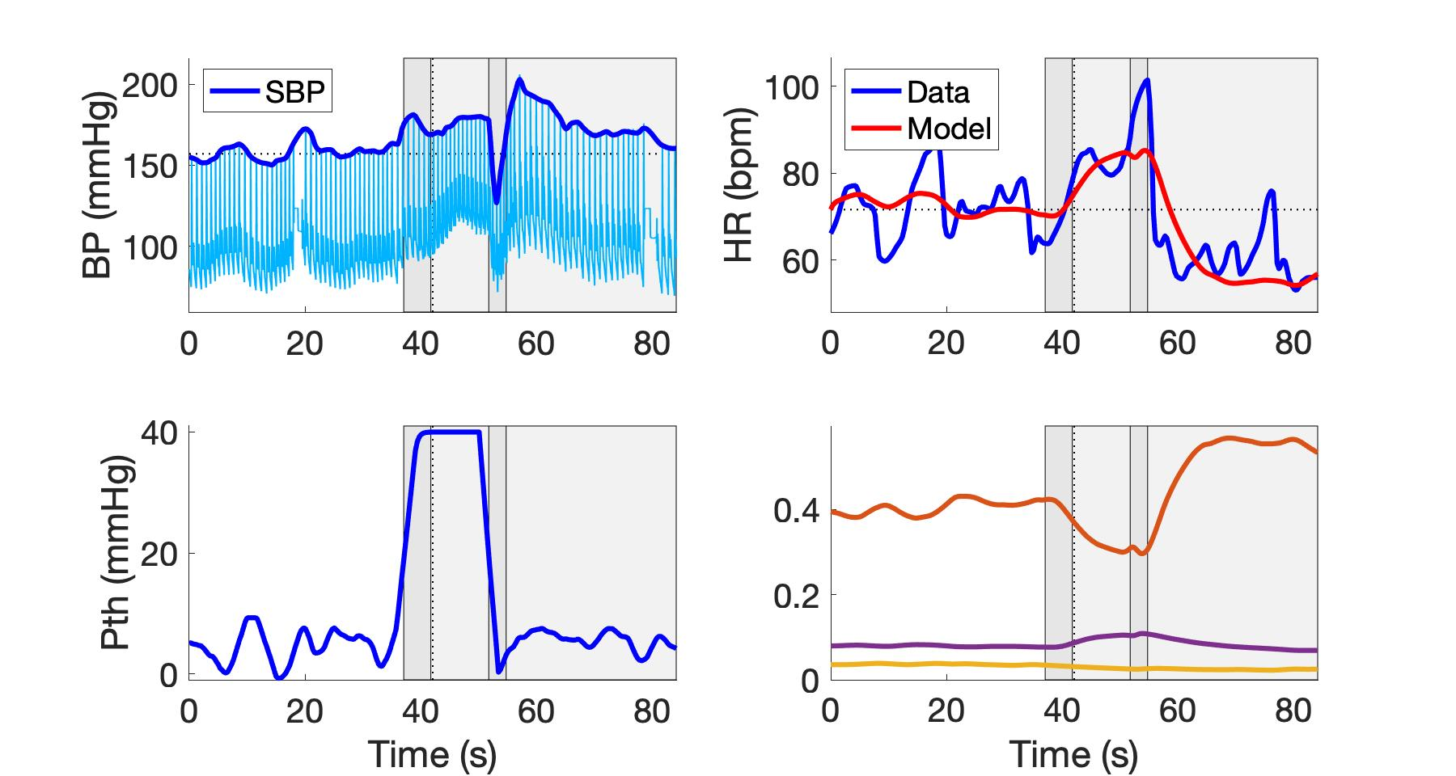
subject_W7VM1.jpeg
Parasympathetic
Sympathetic
Respiratory

Slide 29
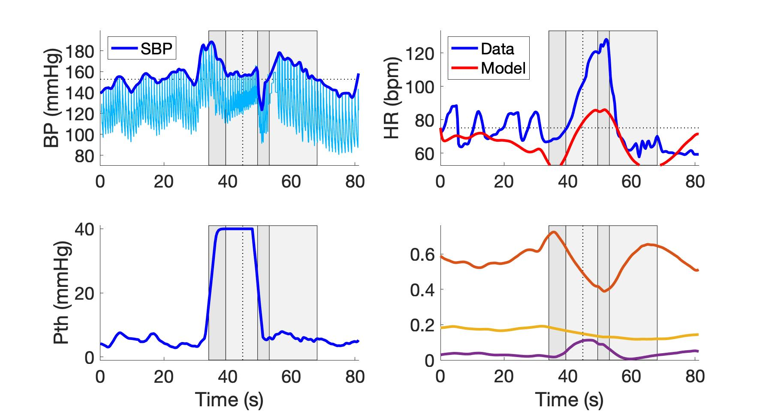
subject_W10VM1.jpeg
Parasympathetic
Sympathetic
Respiratory

Slide 30
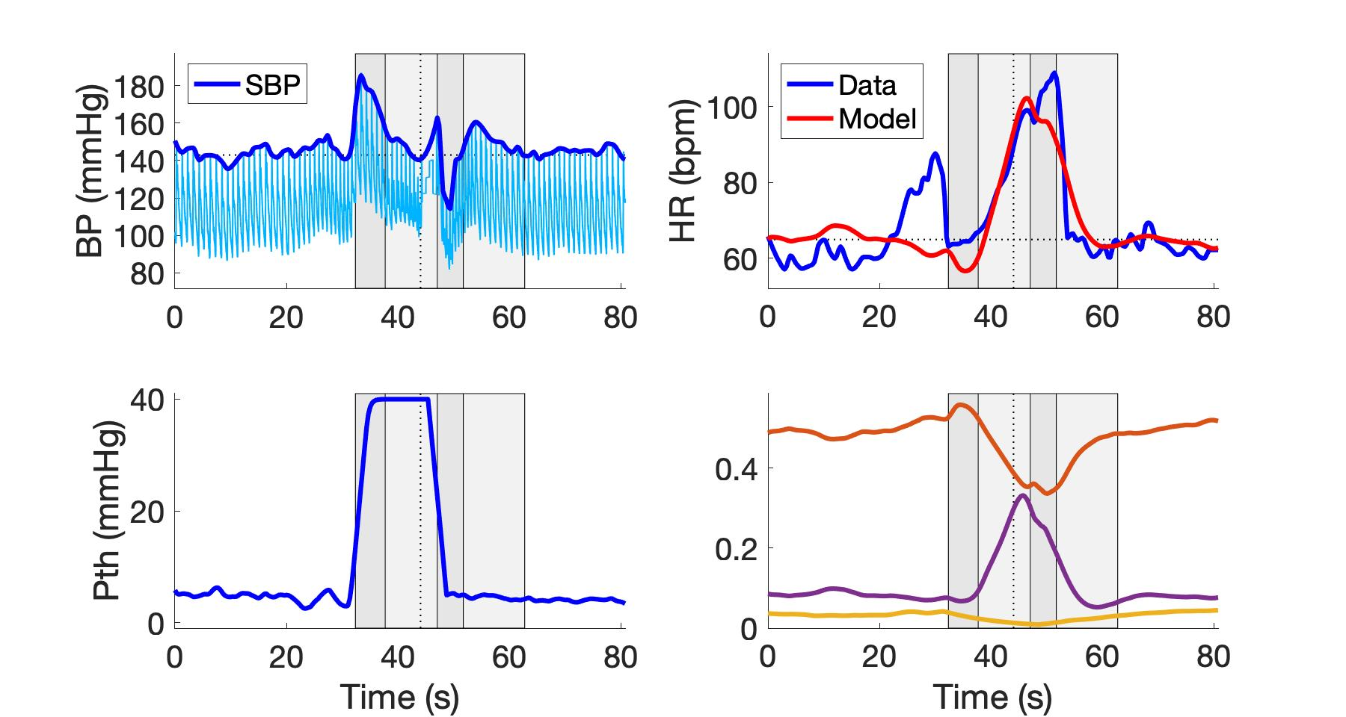
subject_W10VM2.jpeg
Parasympathetic
Sympathetic
Respiratory

Slide 31
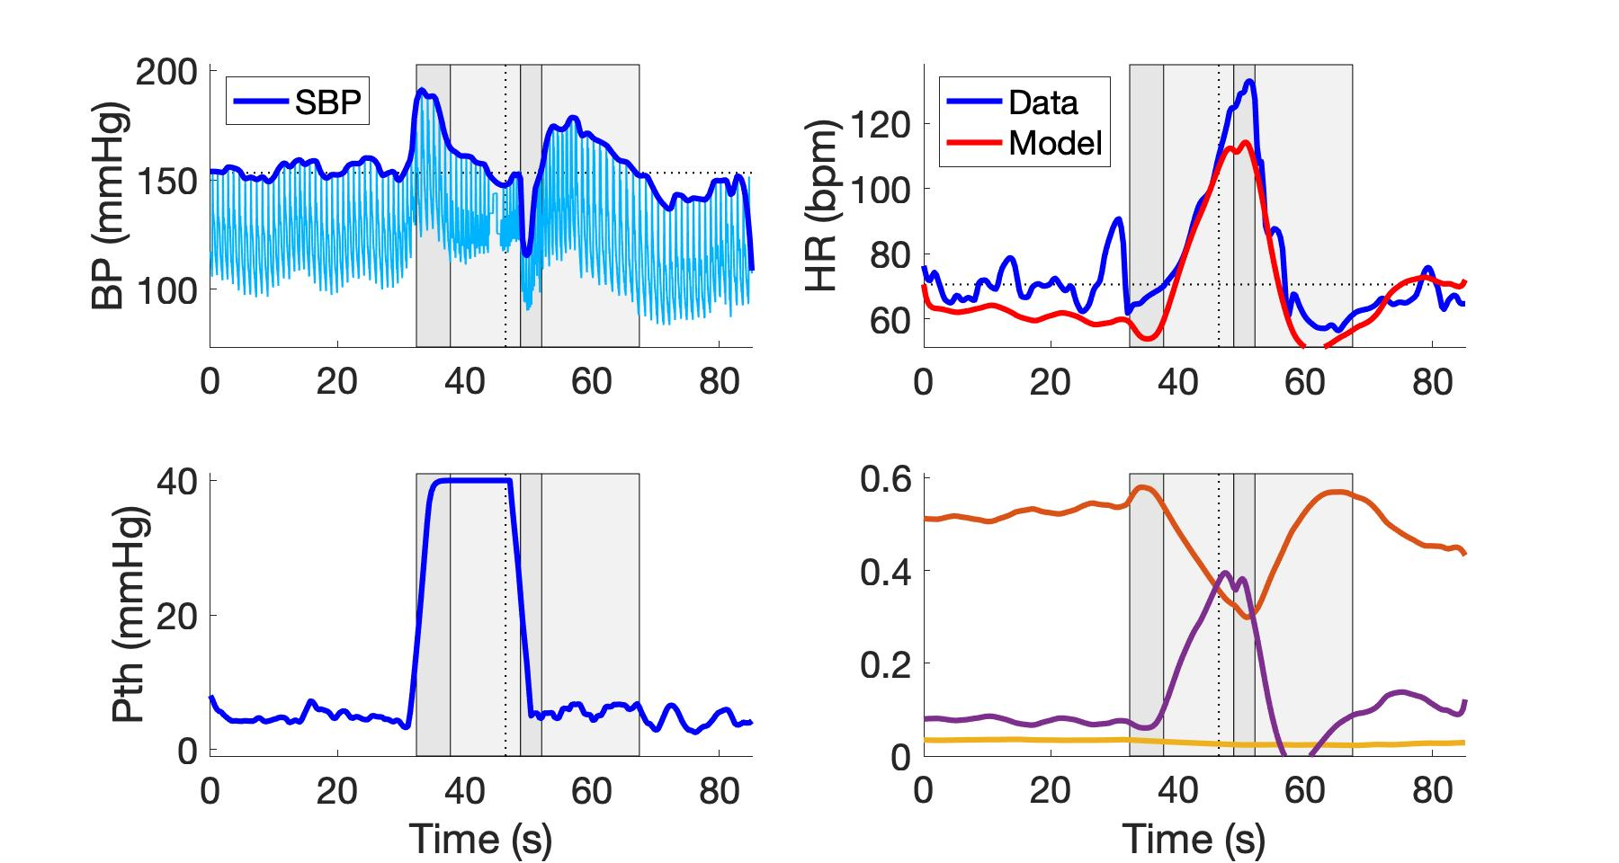
subject_W10VM3.jpeg
Parasympathetic
Sympathetic
Respiratory

Slide 32
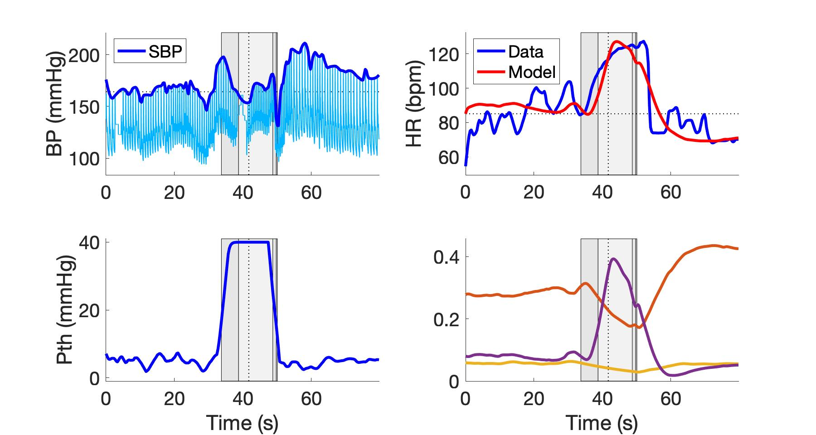
subject_W11VM1.jpeg
Parasympathetic
Sympathetic
Respiratory

Slide 33
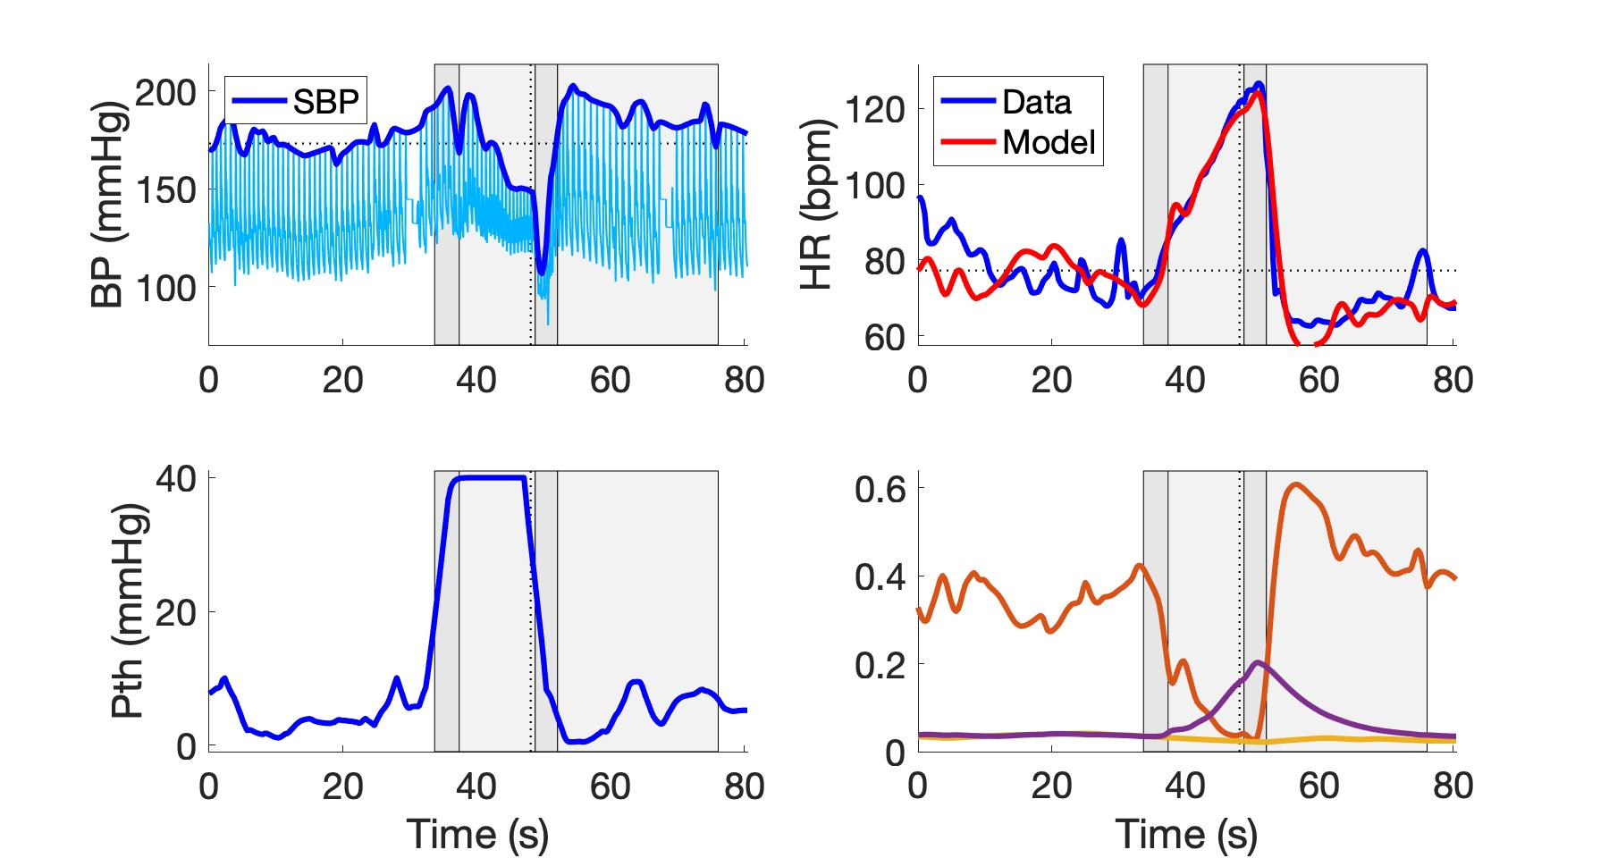
subject_W11VM2.jpeg
Parasympathetic
Sympathetic
Respiratory

Slide 34
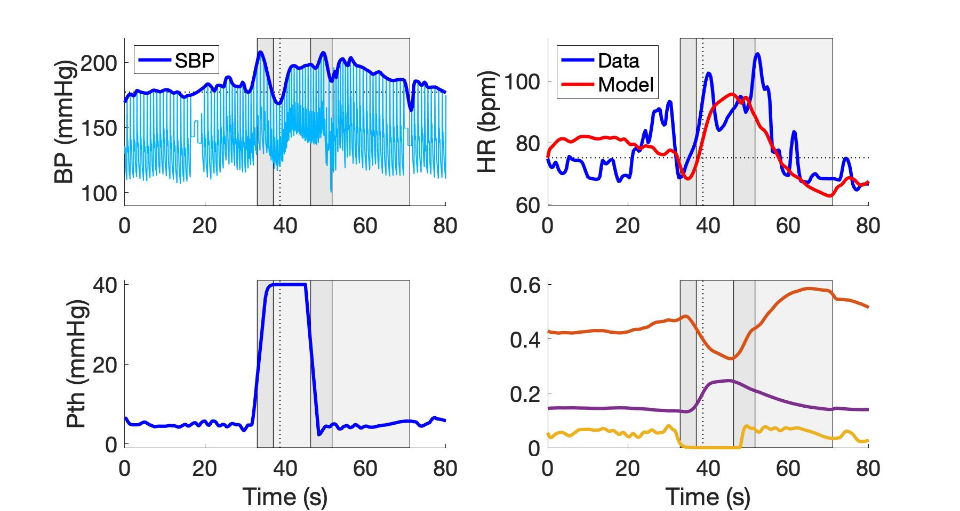
subject_W11VM3.jpeg
Parasympathetic
Sympathetic
Respiratory

Slide 35
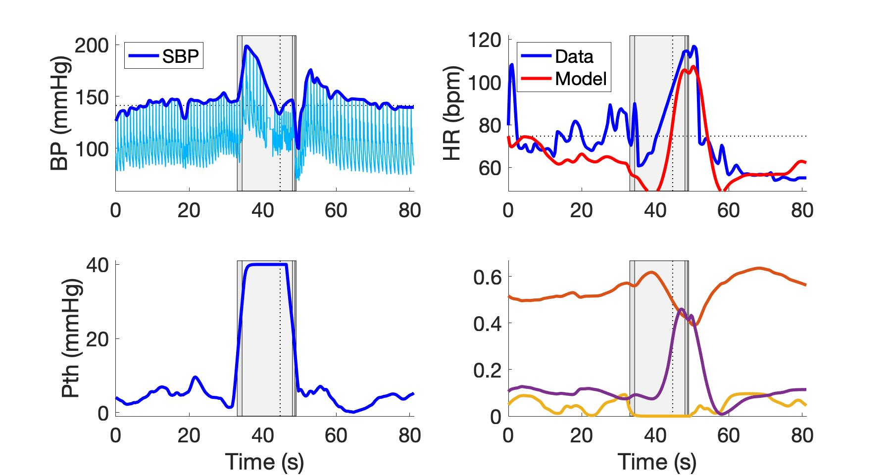
subject_W13VM1.jpeg
Parasympathetic
Sympathetic
Respiratory

Slide 36
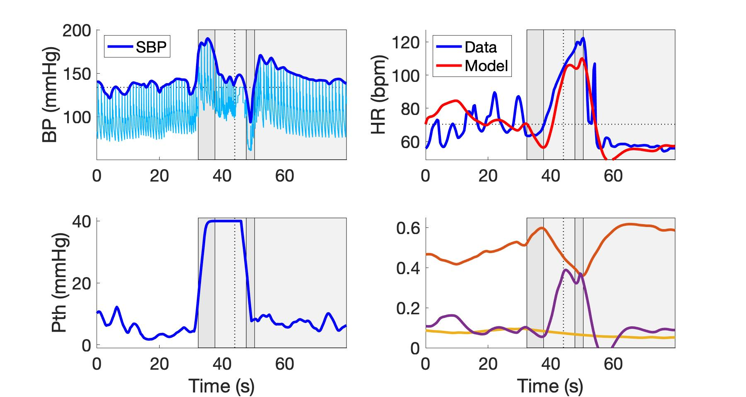
subject_W13VM2.jpeg
Parasympathetic
Sympathetic
Respiratory

Slide 37
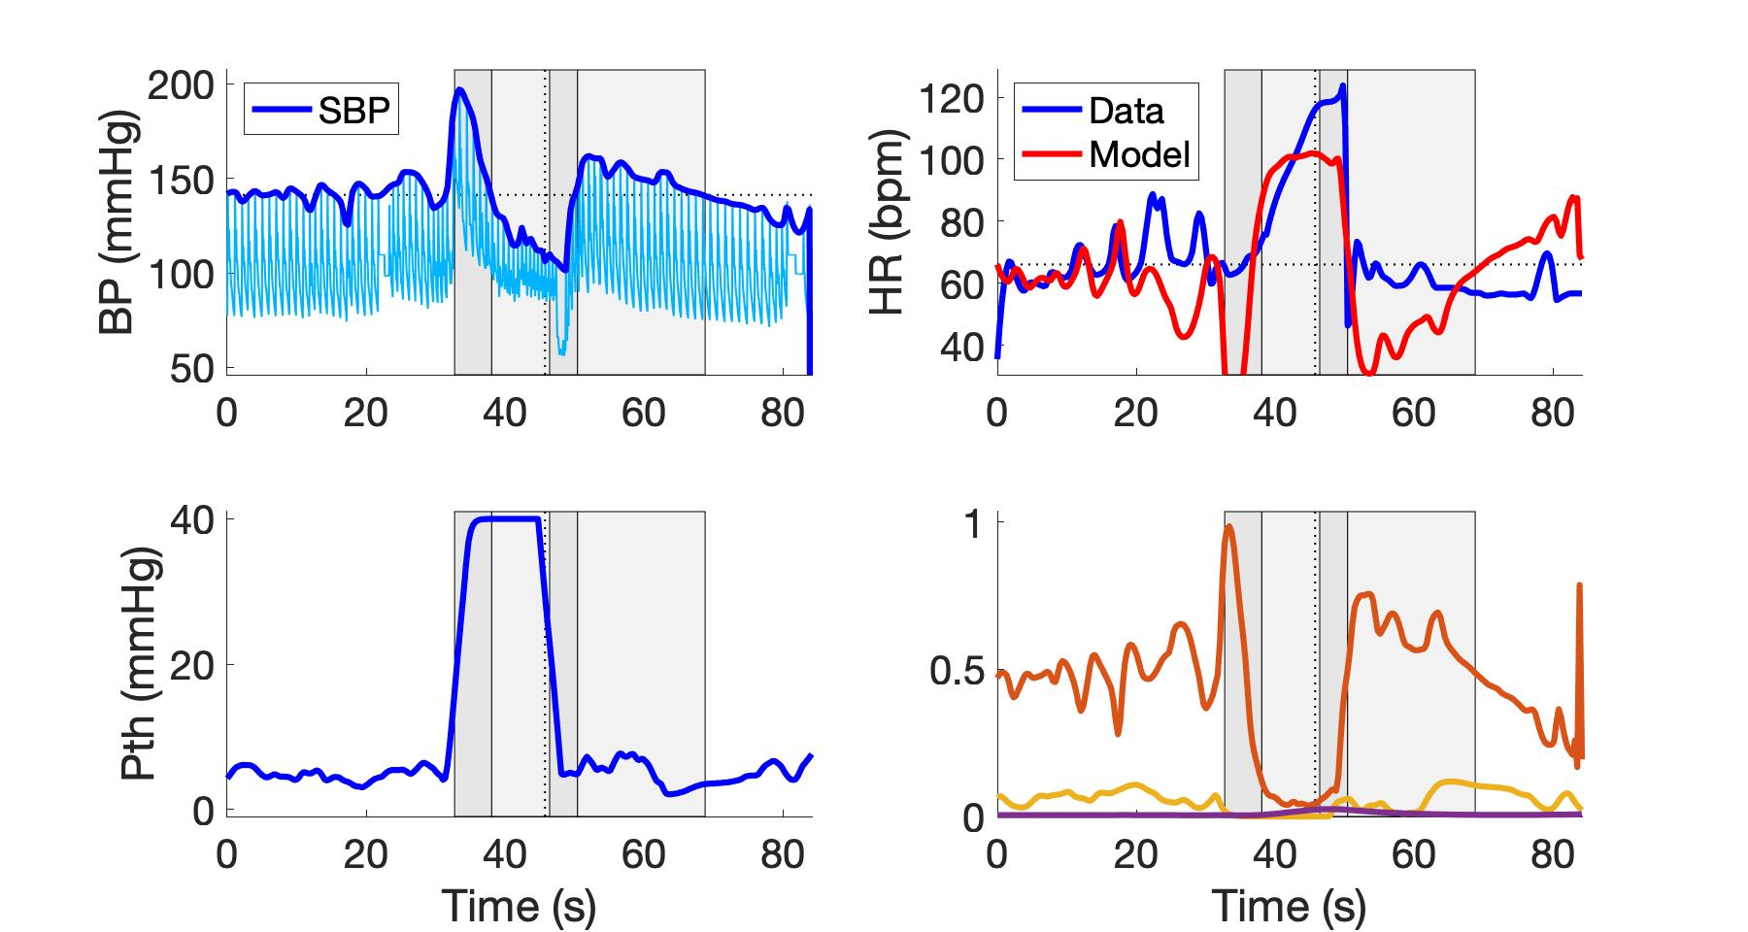
subject_W13VM3.jpeg
Parasympathetic
Sympathetic
Respiratory

Slide 38
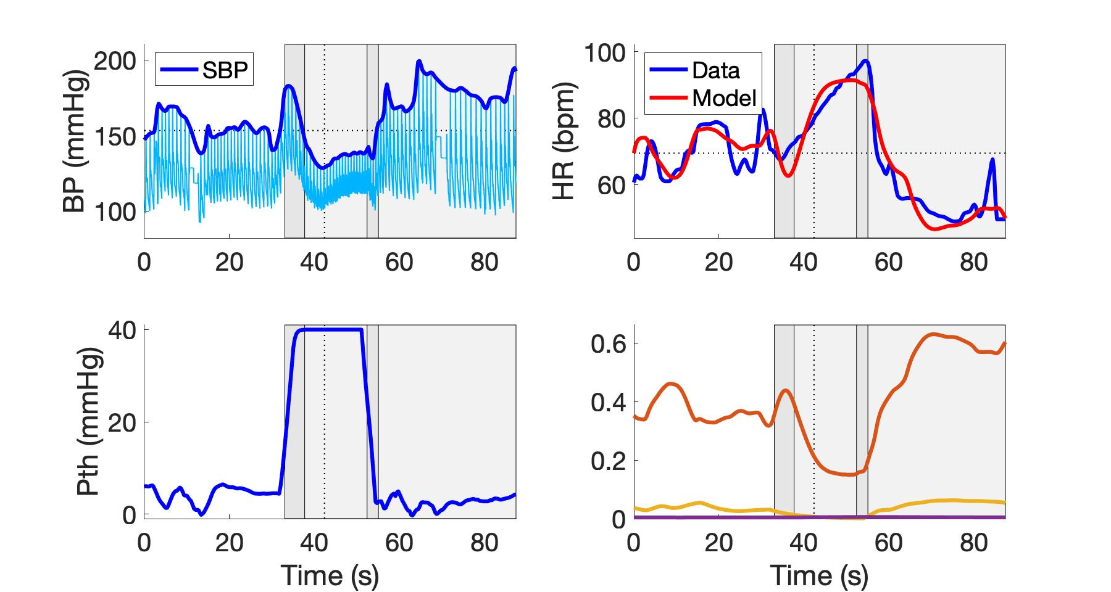
subject_W14VM1.jpeg
Parasympathetic
Sympathetic
Respiratory

Slide 39
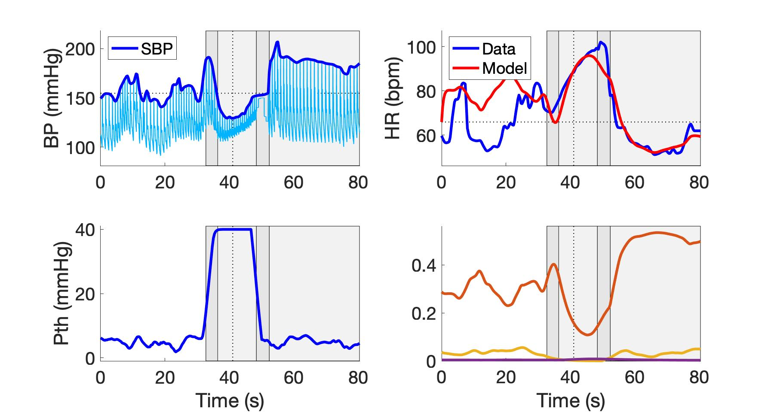
subject_W14VM2.jpeg
Parasympathetic
Sympathetic
Respiratory

Slide 40
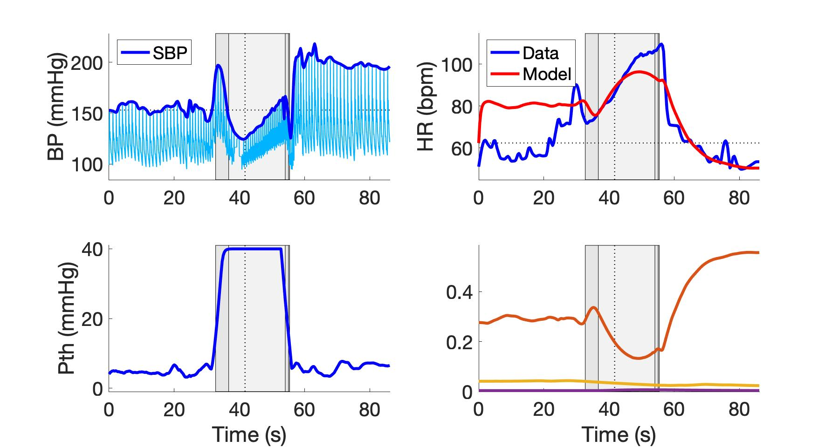
subject_W14VM3.jpeg
Parasympathetic
Sympathetic
Respiratory

Slide 41
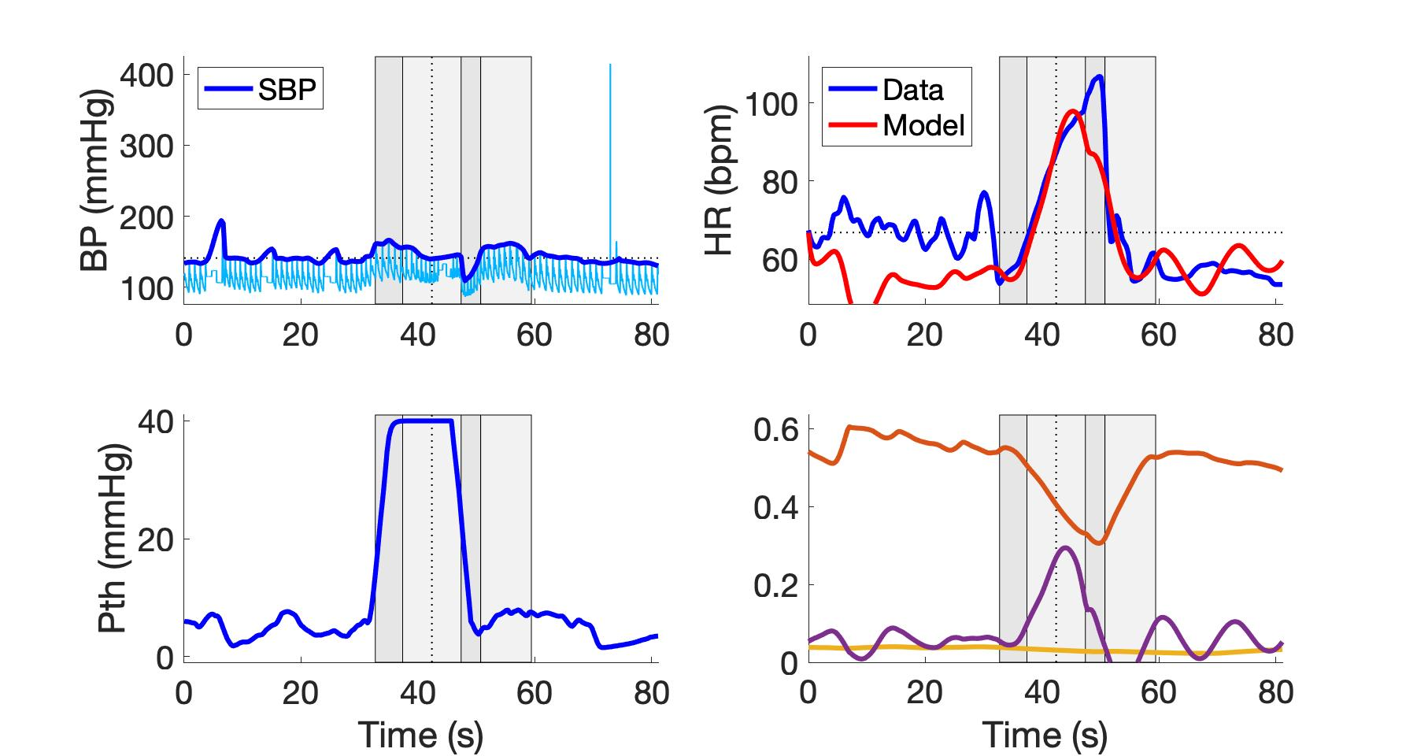
subject_W3VM2.jpeg
Parasympathetic
Sympathetic
Respiratory

Slide 42
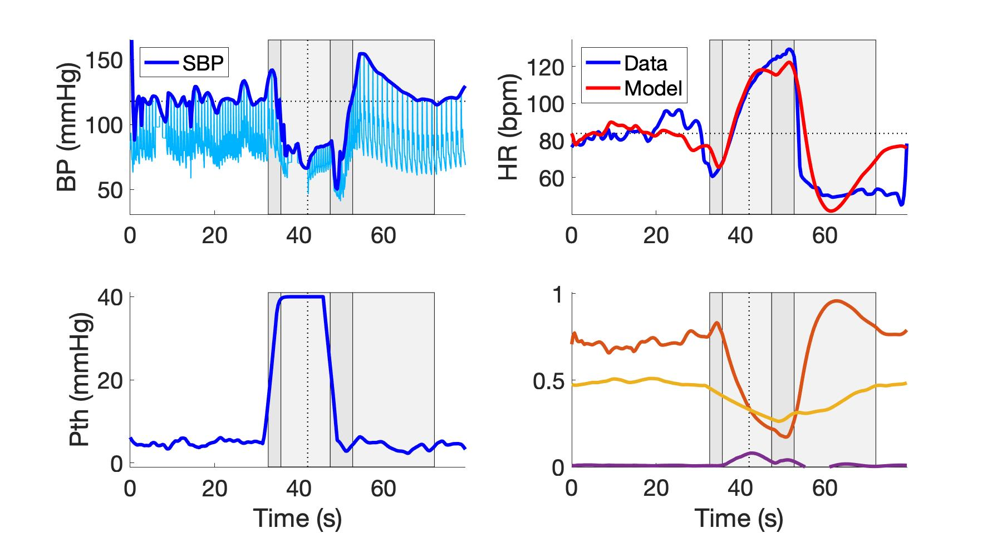
subject_W17VM2.jpeg
Parasympathetic
Sympathetic
Respiratory

Slide 43
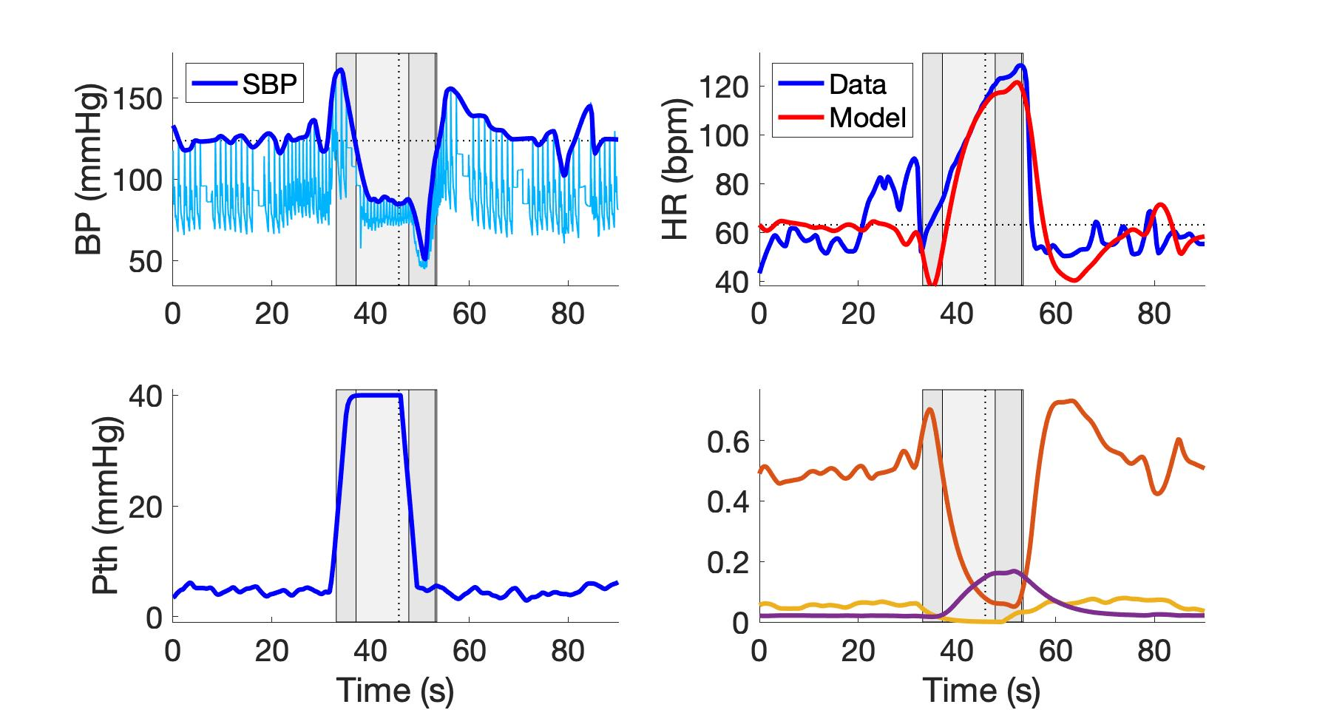
subject_W17VM3.jpeg
Parasympathetic
Sympathetic
Respiratory

Slide 44
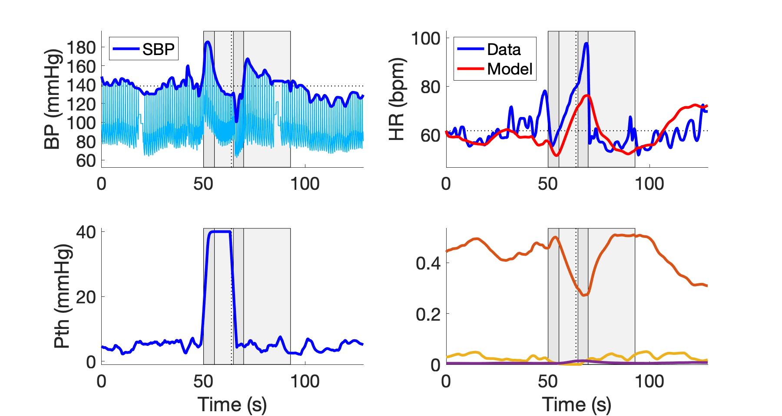
subject_W20VM2.jpeg
Parasympathetic
Sympathetic
Respiratory

Slide 45
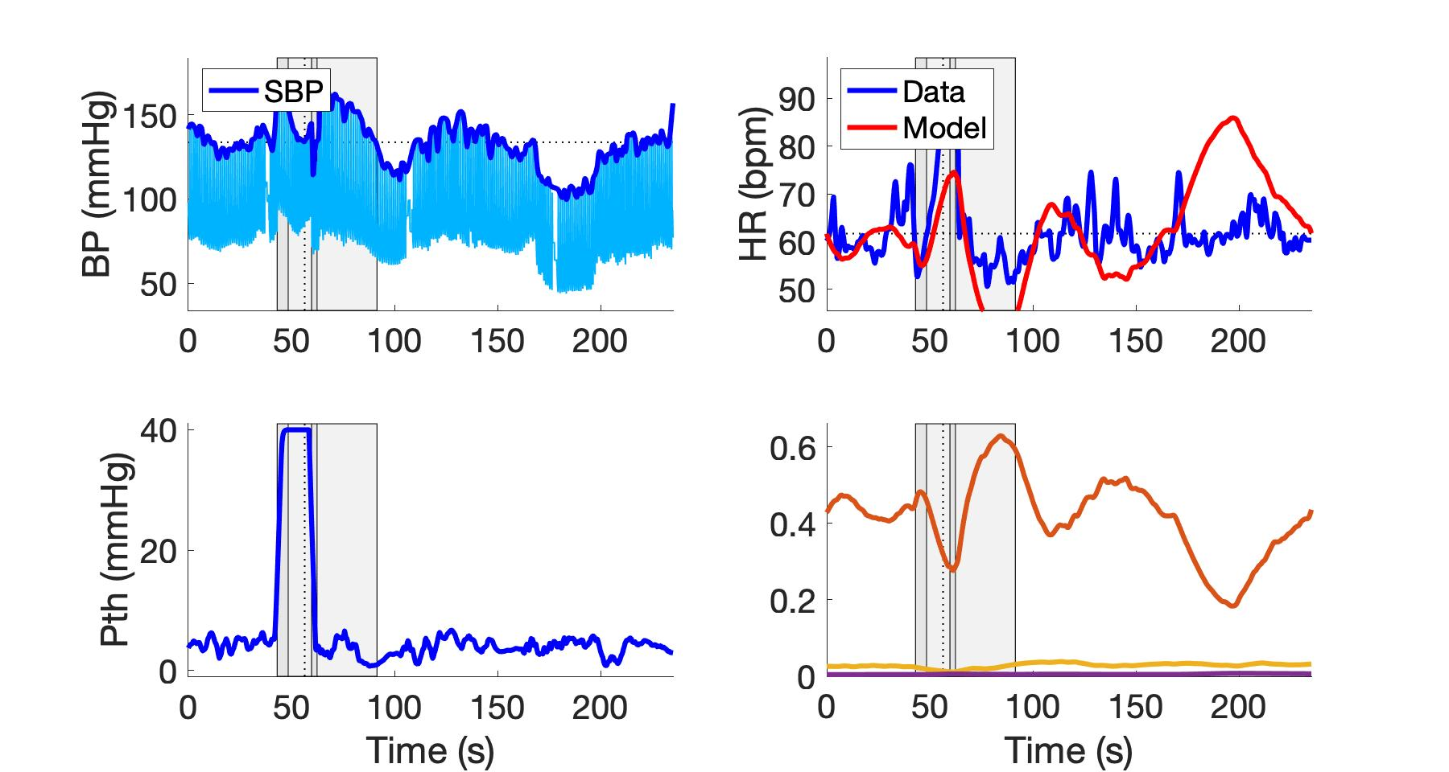
subject_W20VM3.jpeg
Parasympathetic
Sympathetic
Respiratory

Slide 46
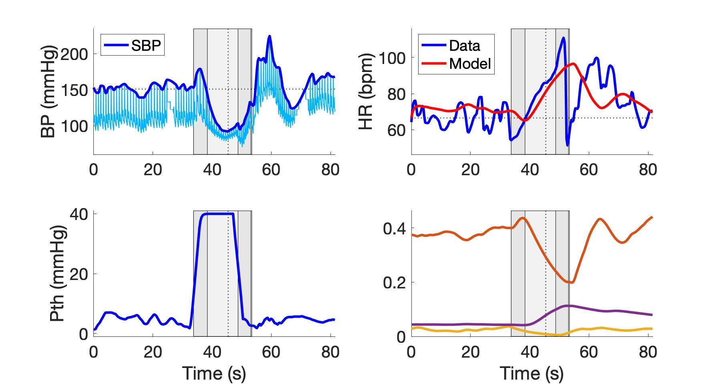
subject_W4VM2.jpeg
Parasympathetic
Sympathetic
Respiratory

Slide 47
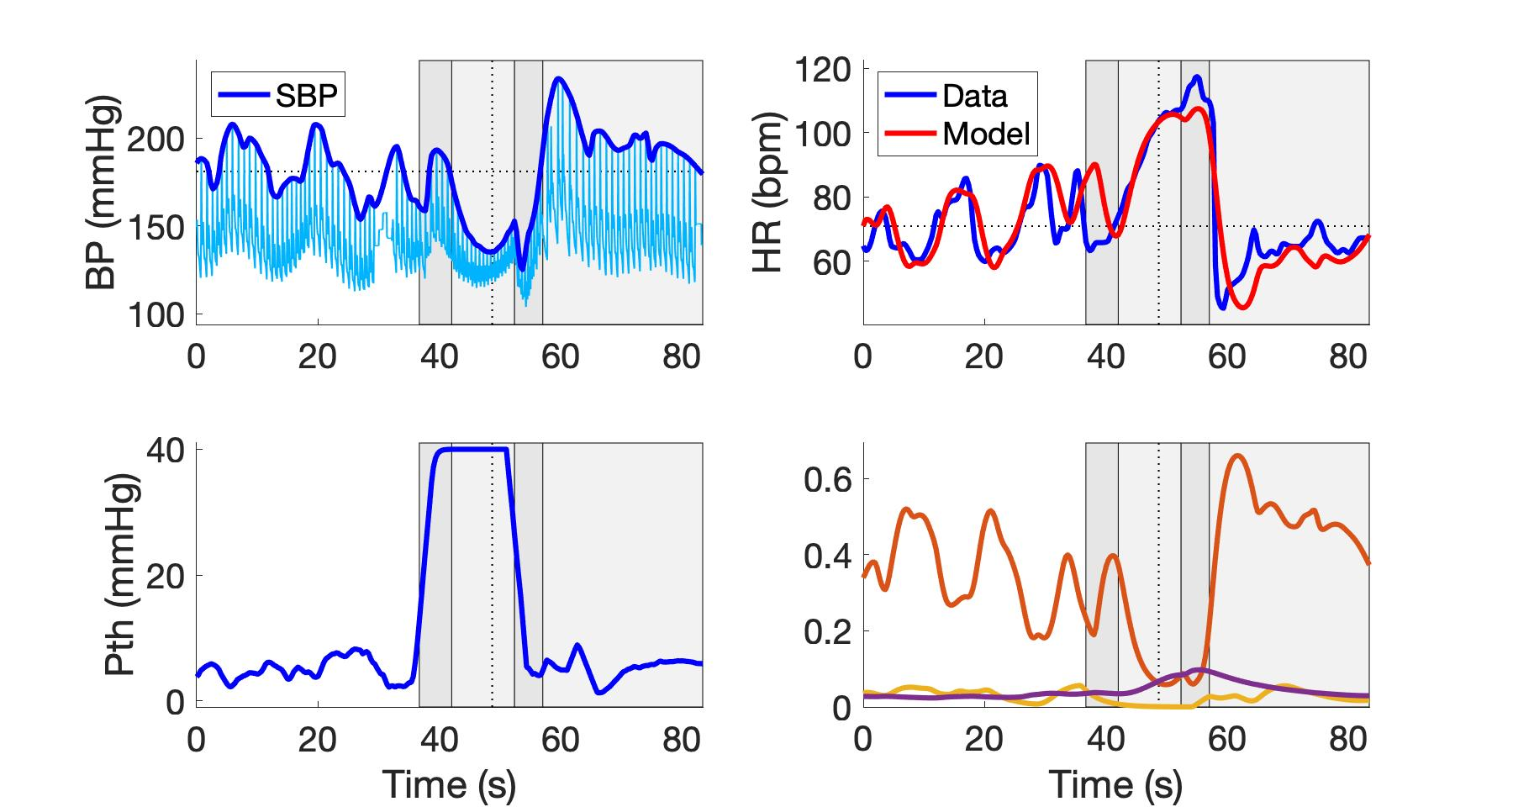
subject_W4VM3.jpeg
Parasympathetic
Sympathetic
Respiratory

Slide 48
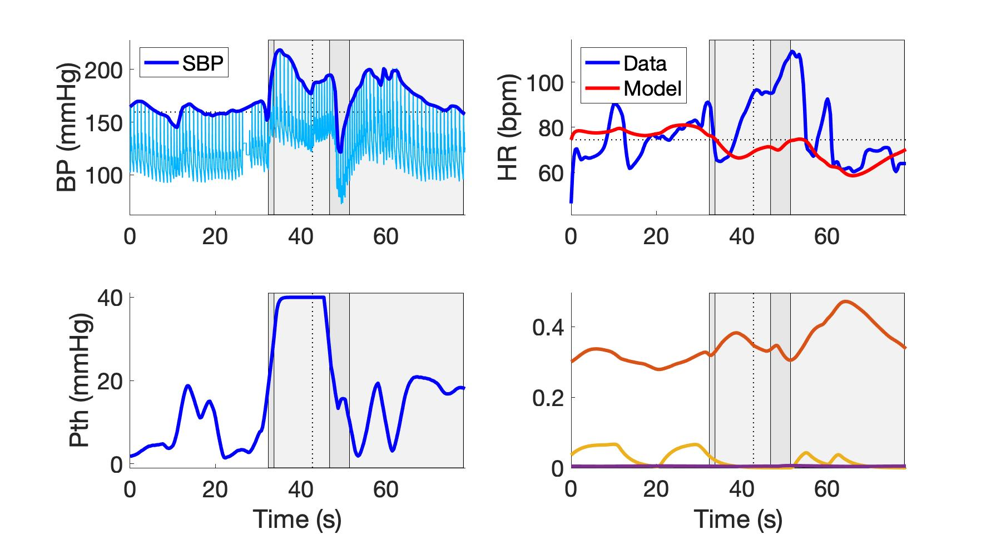
subject_W2VM1.jpeg
Parasympathetic
Sympathetic
Respiratory

Slide 49
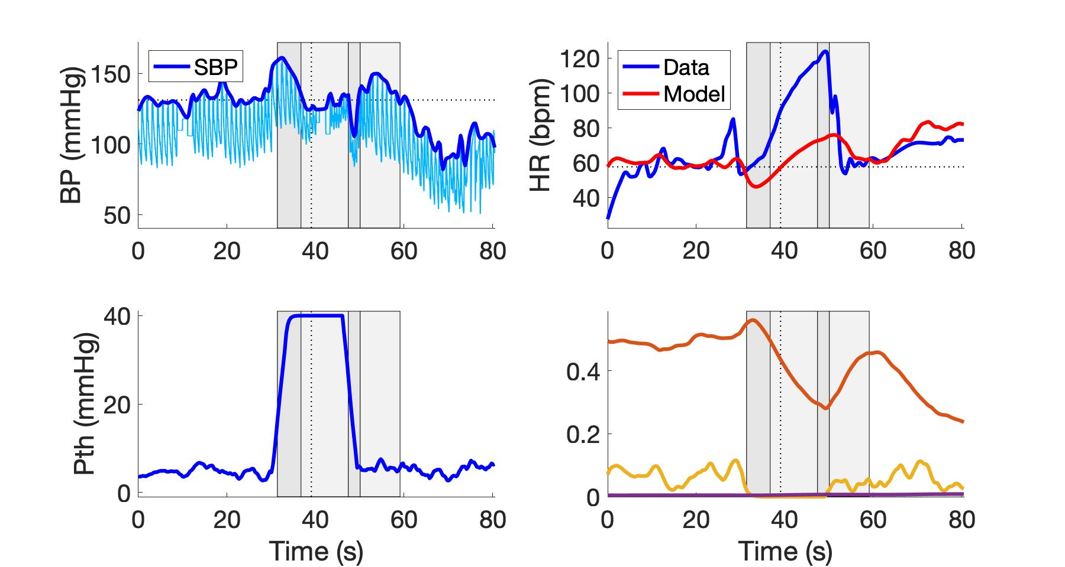
subject_W15VM2.jpeg
Parasympathetic
Sympathetic
Respiratory

Slide 50
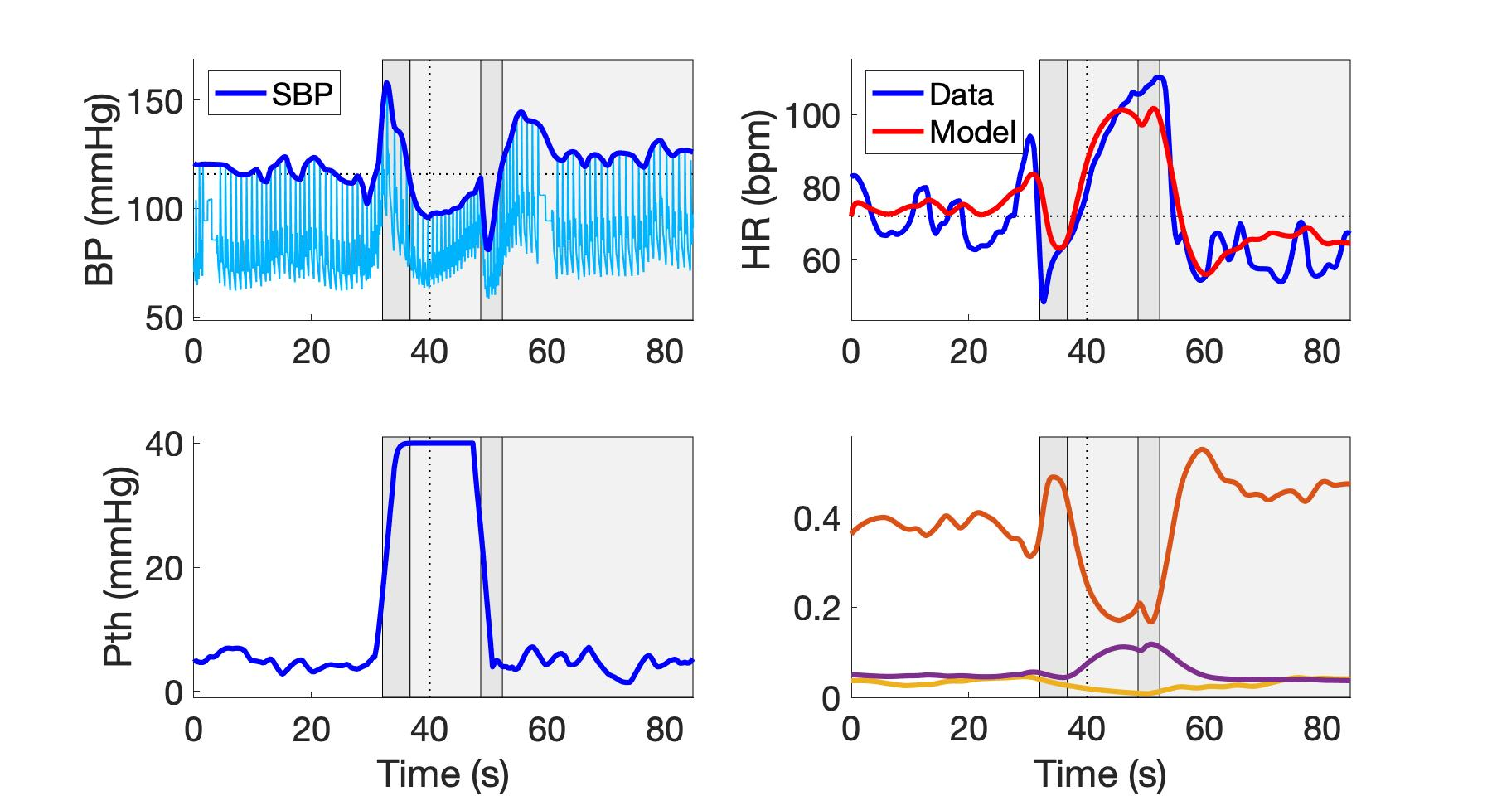
subject_W17VM1.jpeg
Parasympathetic
Sympathetic
Respiratory

Slide 51
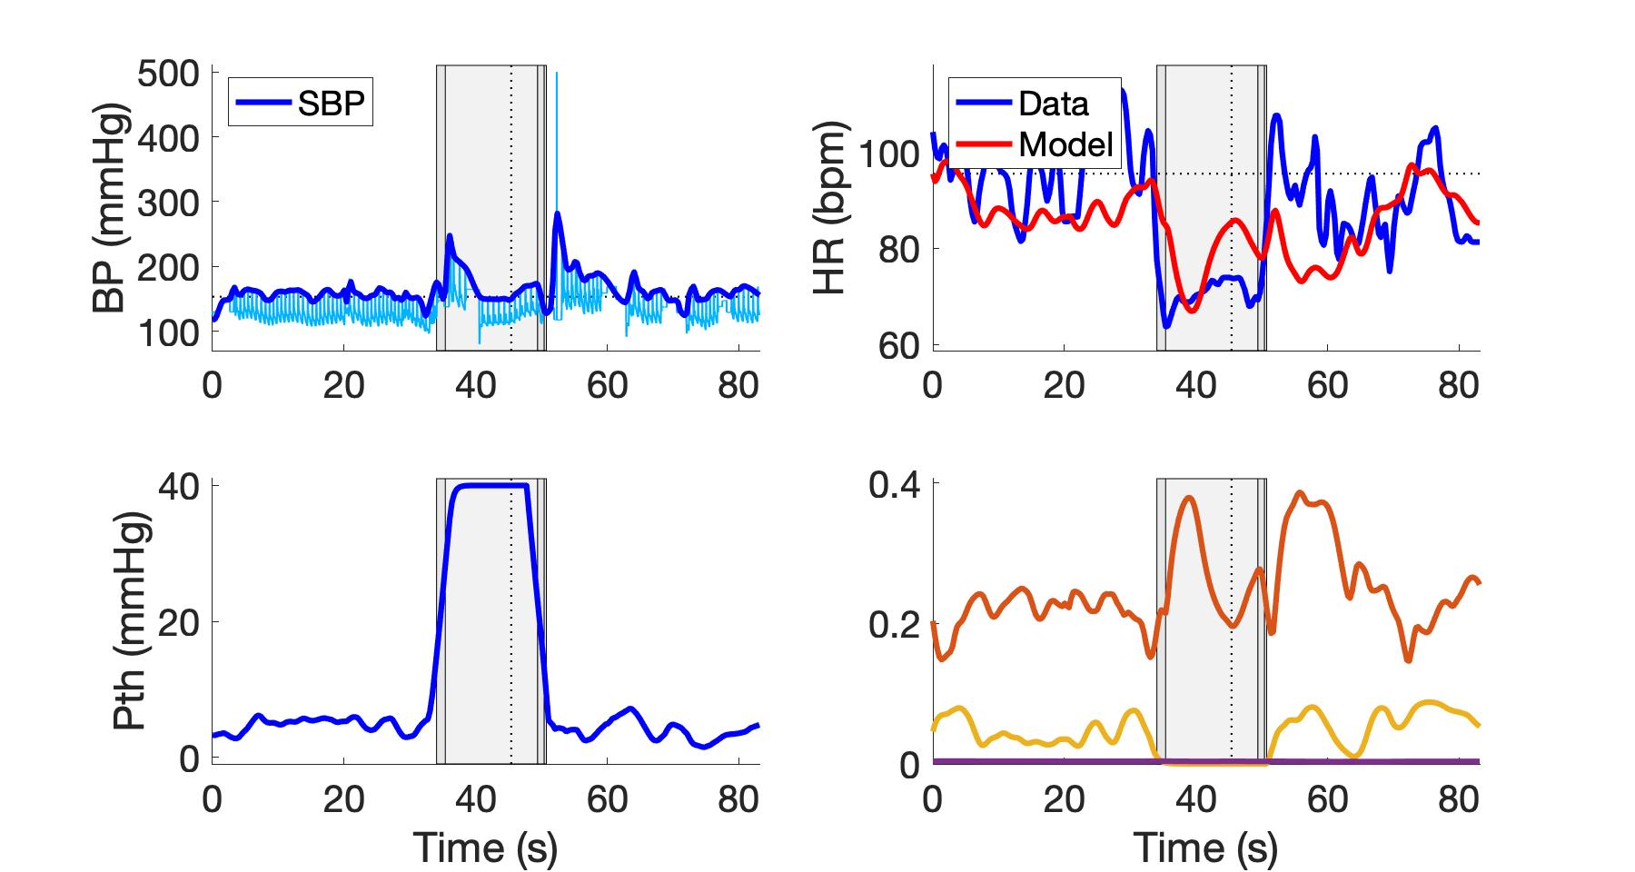
subject_W22VM3.jpeg
Parasympathetic
Sympathetic
Respiratory

Slide 52
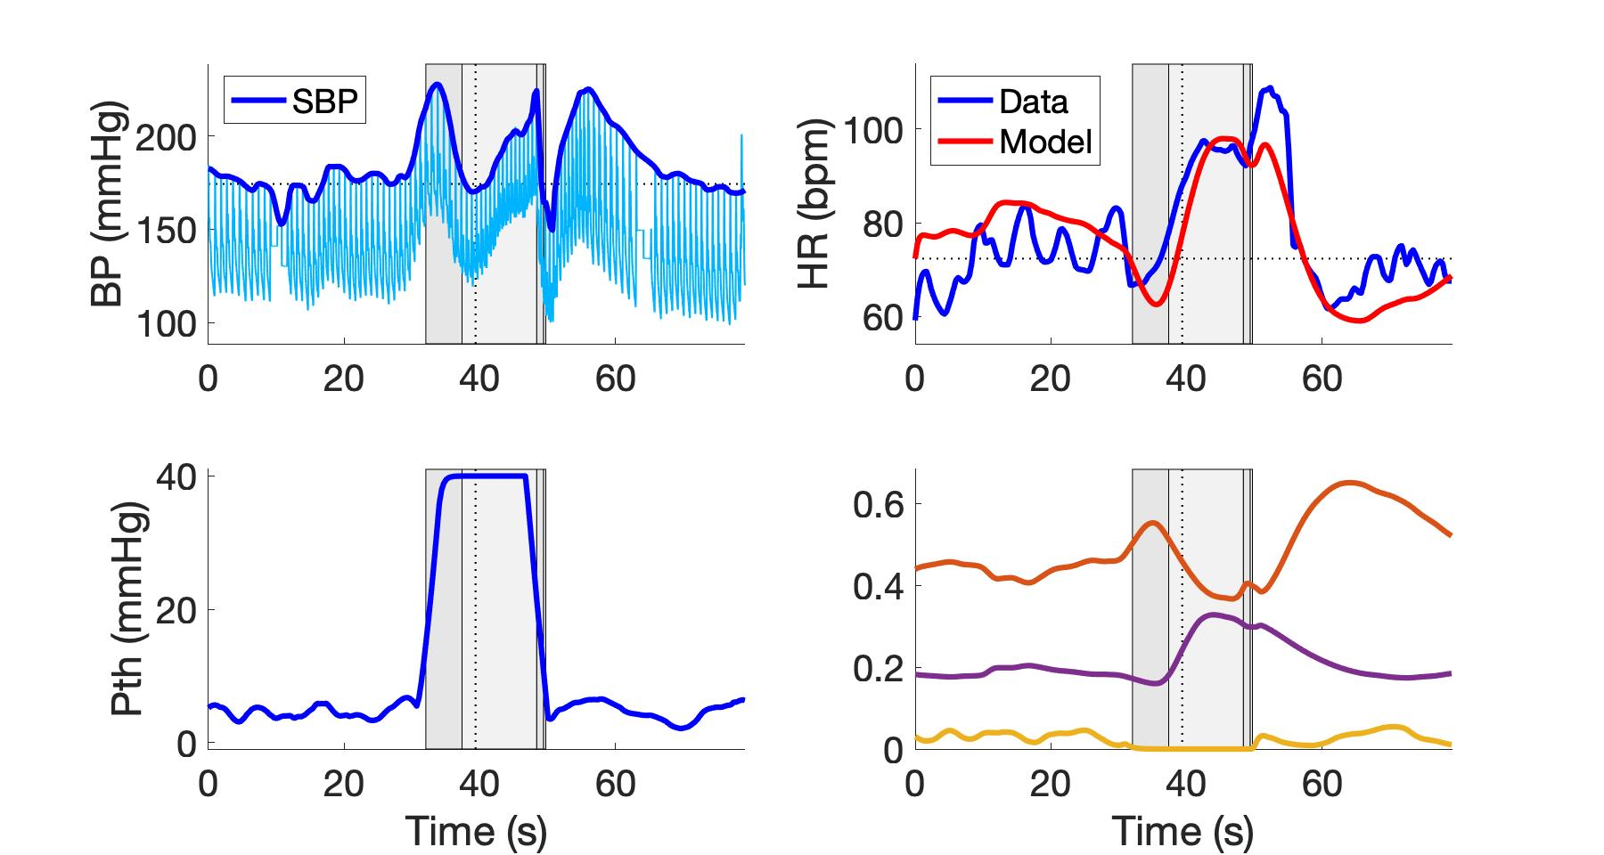
subject_W25VM1.jpeg
Parasympathetic
Sympathetic
Respiratory

